Slide 1
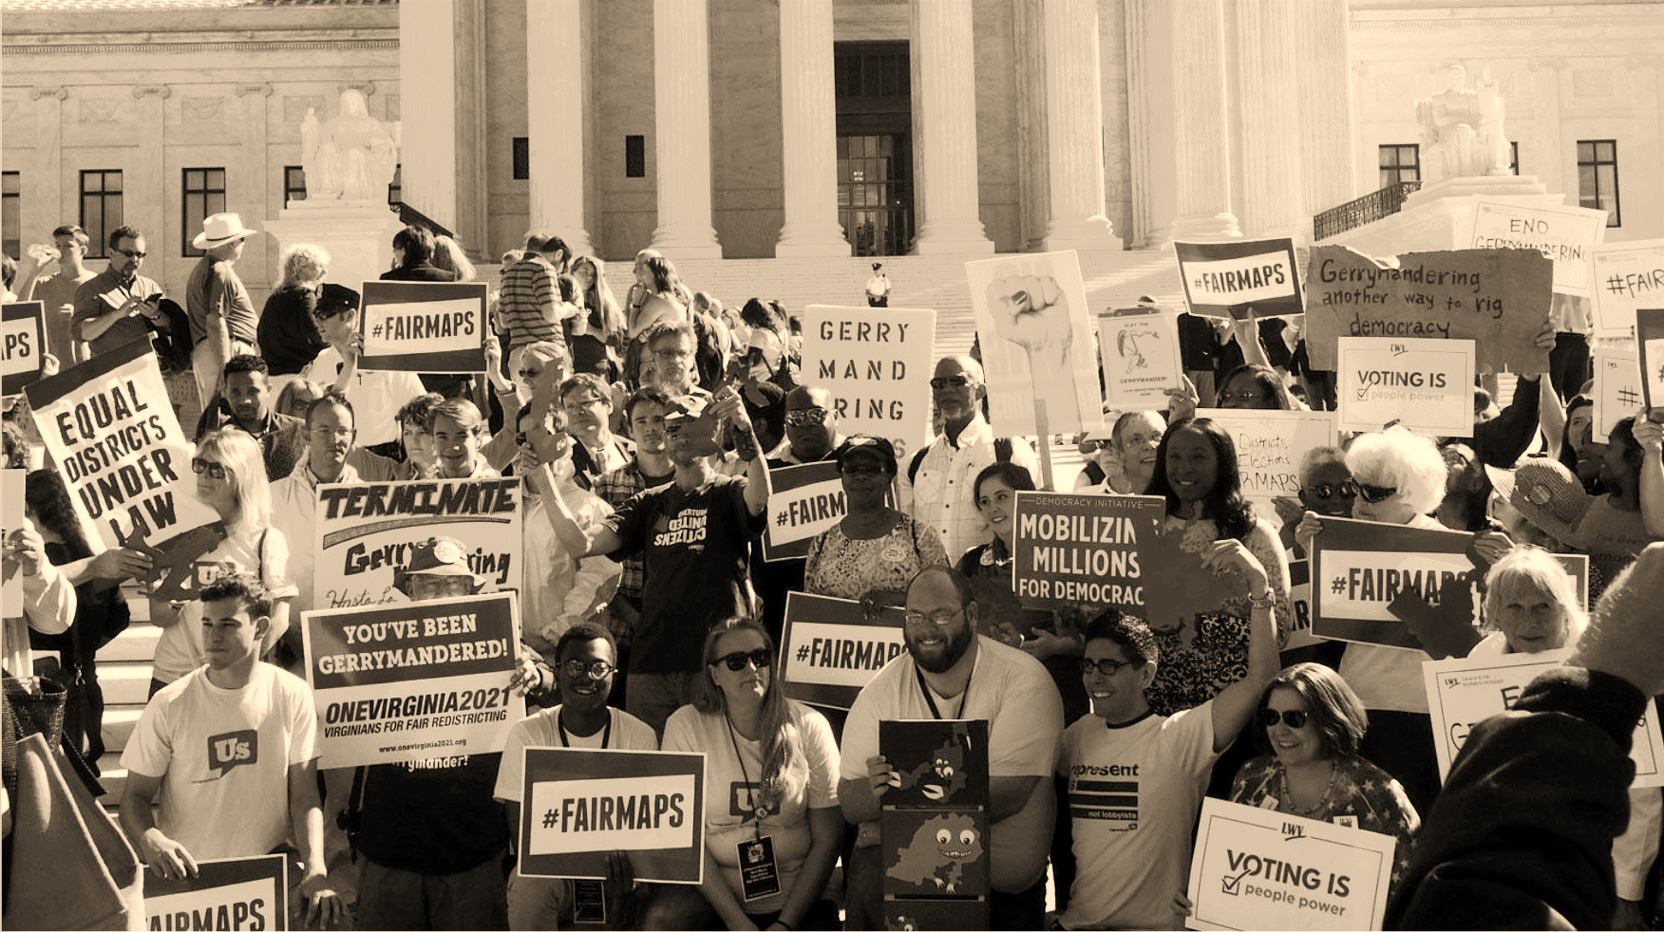
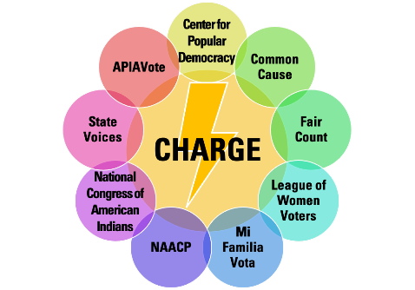
Redistricting Advocacy:
Improving Transparency & Providing Testimony
Notes:
Introduce yourself

Slide 2
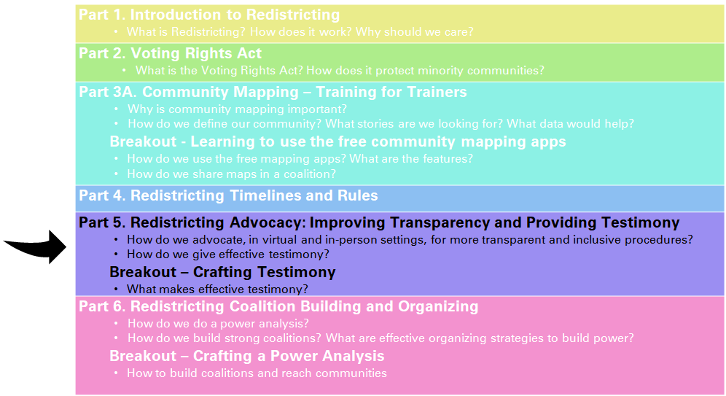
Redistricting Community College: Curriculum
Notes:
Section five of this redistricting training will now cover a broad overview of redistricting advocacy, transparency measures, and ways to deliver strong public testimony.
After we review this section, we will move into breakout groups to further practice how to create and deliver testimony. This will be a good chance for folks to include all the information that we’ve learned about the redistricting basics, VRA requirements, and COI mapping into a short personal statement.
We want to make sure people understand how to use advocacy strategies during redistricting and highlight some of the most effective methods. Due to COVID, we’ll spend some time discussing the digital or virtual strategies that state groups might want to consider.
We’ll review what makes a strong public testimony and some of the best practices to include
Finally, we’ll cover how state advocates can work to ensure a redistricting process is accessible and transparent. We know that COVID protocols may push some states towards closed meetings or limited public notice.
For folks that are just tuning into the training now, this is section 5 in the redistricting community training. Previous sections covered the 101s of redistricting, VRA requirements, community of interest mapping, and state timelines. The next section will close our training out with tips on creating an organizing campaign and building strong coalition power. If you have any questions about the training materials or would like to request another training, please contact chargehub@statevoices.org

Slide 3
Redistricting Advocacy: Overview
Why is advocacy important during redistricting
How to deliver strong public testimony
What are ways to increase accessibility and transparency in the redistricting process
How are advocacy and transparency connected
Notes:
Section five of this redistricting training will now cover a broad overview of redistricting advocacy, transparency measures, and ways to deliver strong public testimony.
After we review this section, we will move into breakout groups to further practice how to create and deliver testimony. This will be a good chance for folks to include all the information that we’ve learned about the redistricting basics, VRA requirements, and COI mapping into a short personal statement.
We want to make sure people understand how to use advocacy strategies during redistricting and highlight some of the most effective methods. Due to COVID, we’ll spend some time discussing the digital or virtual strategies that state groups might want to consider.
We’ll review what makes a strong public testimony and some of the best practices to include
Finally, we’ll cover how state advocates can work to ensure a redistricting process is accessible and transparent. We know that COVID protocols may push some states towards closed meetings or limited public notice.
For folks that are just tuning into the training now, this is section 5 in the redistricting community training. Previous sections covered the 101s of redistricting, VRA requirements, community of interest mapping, and state timelines. The next section will close our training out with tips on creating an organizing campaign and building strong coalition power. If you have any questions about the training materials or would like to request another training, please contact chargehub@statevoices.org

Slide 4
Redistricting Advocacy:
Why it matters
Gives communities a voice & access to the political process
May create maps that better represent all communities
Allows for community oversight in the process
Created by
Notes:
Advocacy around redistricting at the state and local level can yield big results in support of your redistricting goals while also giving volunteers and organizers engagement opportunities to share their story with elected officials or commissioners.
Getting the public involved in the redistricting process is a great to give a voice to communities and creates access to the political process. Many groups and communities have never engaged with redistricting so this is a opportunity to bring more voices into a space that has traditionally been full of legislators, lobbyists, and other outside-actors.
Through community input and testimony, there is more of chance that mapping plans will be adopted that reflect how communities see themselves and build more political power for under-represented groups that have been split into multiple districts.
Finally- advocacy and engagement allows for stronger oversight of the mapping process. Through public testimony and other engagement strategies, legislators and commissioners can be held more accountable.

Slide 5
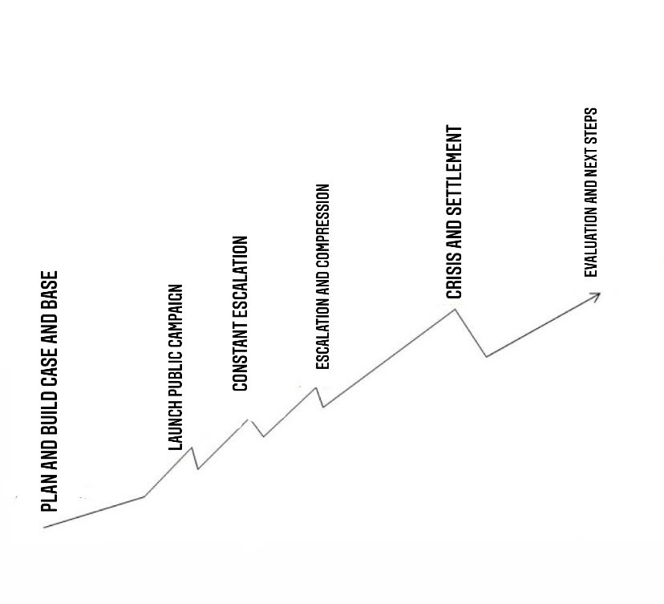
Redistricting Advocacy:
Direct action campaigns
Plan and build case and base
Launch public campaign
Constant escalation
Escalation and compression
Crisis and settlement
Evaluation and next steps
Created by

Slide 6
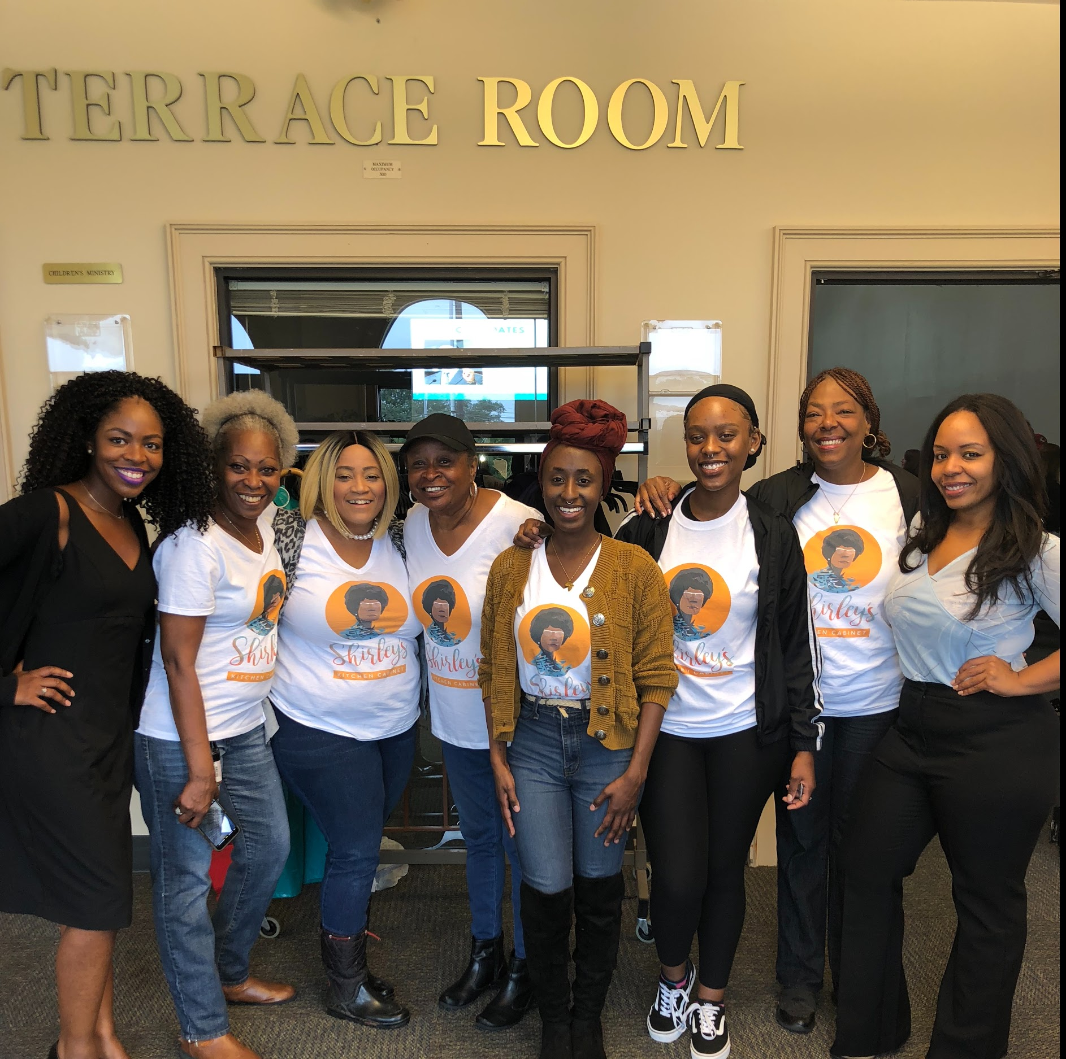
Redistricting Advocacy:
Engagement Strategies
Research who the final decision-makers are.
Advocate for Your Community to get Involved
Research the timelines, rules, and process type of redistricting your state or local area is using.
Connect with civil rights groups who are drafting maps for your area.
Monitor the process and give feedback on the maps as to whether they meet your (or your coalition’s) goals.
Created by
Notes:
Here are some general engagement strategies for advocacy work. These may vary depending on the state or local process but generally speaking:
You’ll want to research who the decision-makers are. In the majority of areas, legislators remain the primary decision-makers for maps. However- a number of states and local areas have changed the way they carry out redistricting to a version of commission. Once decision-makers are identified, it will be important to work with your volunteers and coalitions to map out who are the most effective messengers that should provide testimony. For example, if key decision-makers in MI are majority Flint residents, your volunteers and coalition testimony should probably be from the Flint region.
Second- all engagement strategies should include ways for community members to attend and participate in redistricting hearings and education meetings. The end goal of advocacy is having many people turn out for public testimony however your organization will likely need to invest time in getting communities involved through education sessions or workshops to connect why redistricting matters to specific individuals.
Federal and state redistricting often starts before local efforts. Find out the hearing schedule and the rules for testifying, such as registering, time limits, and submitting written testimony into the record. Be prepared to participate early and often. Being at hearings early in the process will let decision makers know you are serious.
Make your concerns known and work with them to keep your community together in their maps Staying engaged will let you respond quickly to proposed ideas and maps. Since this can be a long process, organizing more people to cover the different hearings will spread the workload to more than a small set of people or organizations.

Slide 7
Redistricting Advocacy:
Virtual & Digital Engagement Strategies
Host virtual hearings and events
Provide written testimony
Share virtual public testimony
Coordinate advocacy calls to legislative or commission committees
Mobilize communities through digital platforms
Create a plan for media coverage through op-eds, letters to the editor, and local interviews
Created by
Notes:
Virtual meetings: Be sure to log in early to familiarize yourself with the representative’s preferred platform, and ensure there are no technology issues. Make sure that all speakers know how to use the software and are coordinated with others who will be speaking. If your state does not offer virtual hearings or events, consider creating your own to capture community input that can be shared with the legislature or commission.
Other ideas for interactive testimony include hosting a screening party to watch hearings on a platform like Zoom.
Check your state legislative website for opportunities to submit written testimony. These websites can also be found, eventually, on the all about redistricting website
Coordinated phone or text campaigns can also be an effective way to engage community members and make sure that legislators and commissioners know what groups think of proposed maps. The LWV and State Voices hosted a webinar on how to use digital tools for redistricting that can be referenced after this training.
Public testimony and turnout at hearings can be an impactful way to show support or opposition to maps. Make sure that you have a large base to attend hearings by promoting information through digital platforms and earned media like op-eds, etc.

Slide 8
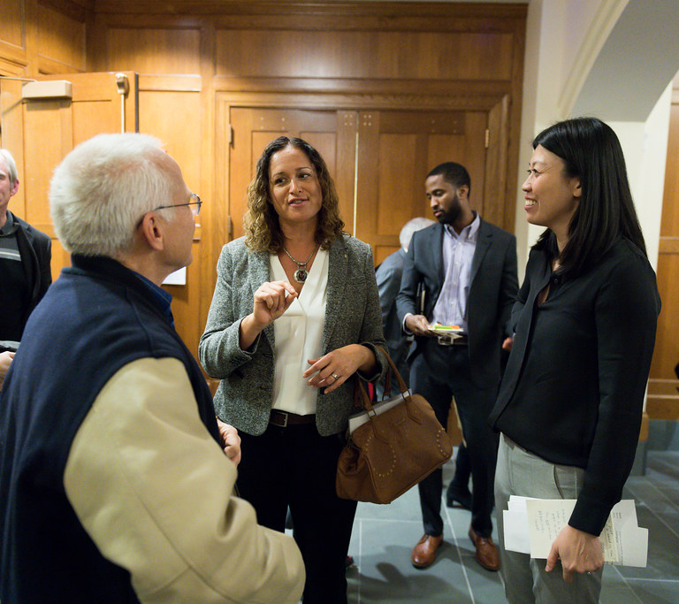
Advocacy Strategies:
Legislative vs. Commission Processes
States with Legislative Process
Decision-Makers: State lawmakers, county commissioners, city council members and others
2. States with Independent Commissions
Decision-Makers: Appointed individuals that may include independent entities and a proportion of elected officials
Created by
Notes:
There are a few things to keep in mind when creating advocacy strategies depending on whether your state or local process runs through the legislative process or a commission.
In states with legislative processes, advocates should be mindful that the notice of public hearings may be difficult to find, not distributed widely, and not posted in a timely manner. There are serious concerns that, due in part to the delayed redistricting data, the legislative process may be less transparent and have a significant amount of ‘behind the scenes’ lobbying activity. We’ll talk about transparency measures shortly.
In states with a commission process, appointed individuals make up the map drawers. Elected officials may also be part of the commission and selection could be done by the state supreme court or other independent entity.

Slide 9
Redistricting Advocacy:
Transparency Measures
Types of Transparency and Accountability Rules in Redistricting
Commissioners and Staff Are Subject to State Ethics Rules/Ethic Commissions
Commissioners and Staff Conflicts of Interest Exclusions
Commissioners and Staff Should Have a Cooling-Off Period
Ban on Solicitation of Gifts by Commissioners and Staff
Prohibition on Employers Retaliation Against Commissioners
Commissions Should Require a Minimal Number of Meetings or Public Hearings Throughout the State
Require All Data Used by the Commission to be made Public in Accessible Formats
Require All Draft Maps and Reports to be Released on a Publicly-Accessible Website
Subject the Commission to State Open Meetings/FOIA Rules
Require a Reasonable Public Comment Period for Proposed Maps
Commissioners Must be Impartial
Establish Removal Procedures for Misconduct
Created by
Notes:
Every so often, newspapers or government watchdog groups like CLC, across the country expose unethical conduct (that may be technically legal) of legislators. From conflicts of interest and “revolving door” issues to campaign finance violations 11, what is clear is that institutional measures establishing ethical rules are vital to help ensure that legislators are behaving ethically while working for the public good. In addition, transparency and accountability rules give members of the public and communities of interest an opportunity to participate and provide feedback during the redistricting process. Thus, to help ensure that electoral maps are drawn in a fair and open manner, ethics and transparency rules should also apply to redistricting commissions. Below are several provisions that can or should apply to the redistricting process in general, but also specifically to redistricting commissions.
https://www.lwv.org/sites/default/files/2021-03/Transparency_Report_FINAL.pdf
From the data hub: https://docs.google.com/document/d/1WSVoVG8FwwUhbKGjhOgQqQ2JTZWNj9KHiLKFEXVLco4/edit

Slide 10
Testifying is ADVOCACY POWER!
Builds skills – for your organization & community
Applies to any issue
Applies to any person or group in power
Gets you/your organization on the record
Builds coalitions
Gets media attention
Created by

Slide 11
Components of Effective Testimony
Building blocks for success
Establishes credentials
Identifies the critical point
Tells a story
Provides evidence & lists consequences
Specifies an “ASK”
Created by
Notes:
From our examples and from the literature about effective testimony we know that there are certain building blocks that make a testimony effective.
First, effective testimony establishes your credentials – who you are.
Second, it clearly identifies the topic and purpose or critical point of your statement
Third. The best testimony tells a story that engages the audience (that is, the commissioners or panel members).
Fourth. Facts or evidence to support your points are succinctly provided.
Consequences of not following your recommendations, if known, might be spelled out.
Lastly, effective testimony closes with a specific “ask” – what you want the
Commission to do.

Slide 12
Preparing your Testimony:
What is a “TESTIMONY”?
Testimony is defined as:
a declaration or statement given in evidence
Written document
Content of what will be said in testifying or submitted in writing
Created by
Notes:
Your testimony is very important, regardless of your prior experience or expertise in writing and giving testimony. The Commissioners want and need to hear from citizens – not just from political parties and lobbyists.
But, just what is Testimony? The dictionary definition indicates that a testimony is a declaration or statement given in evidence of a position.
You will note two key features of testimony
1. It is a WRITTEN document.
Testimony contains the CONTENT of what you will say when testifying
Or it can be the content of what you will submit in writing.
TESTIFYING, on the other hand, is the delivery of your testimony .
Testimony is written; testifying is oral.

Slide 13
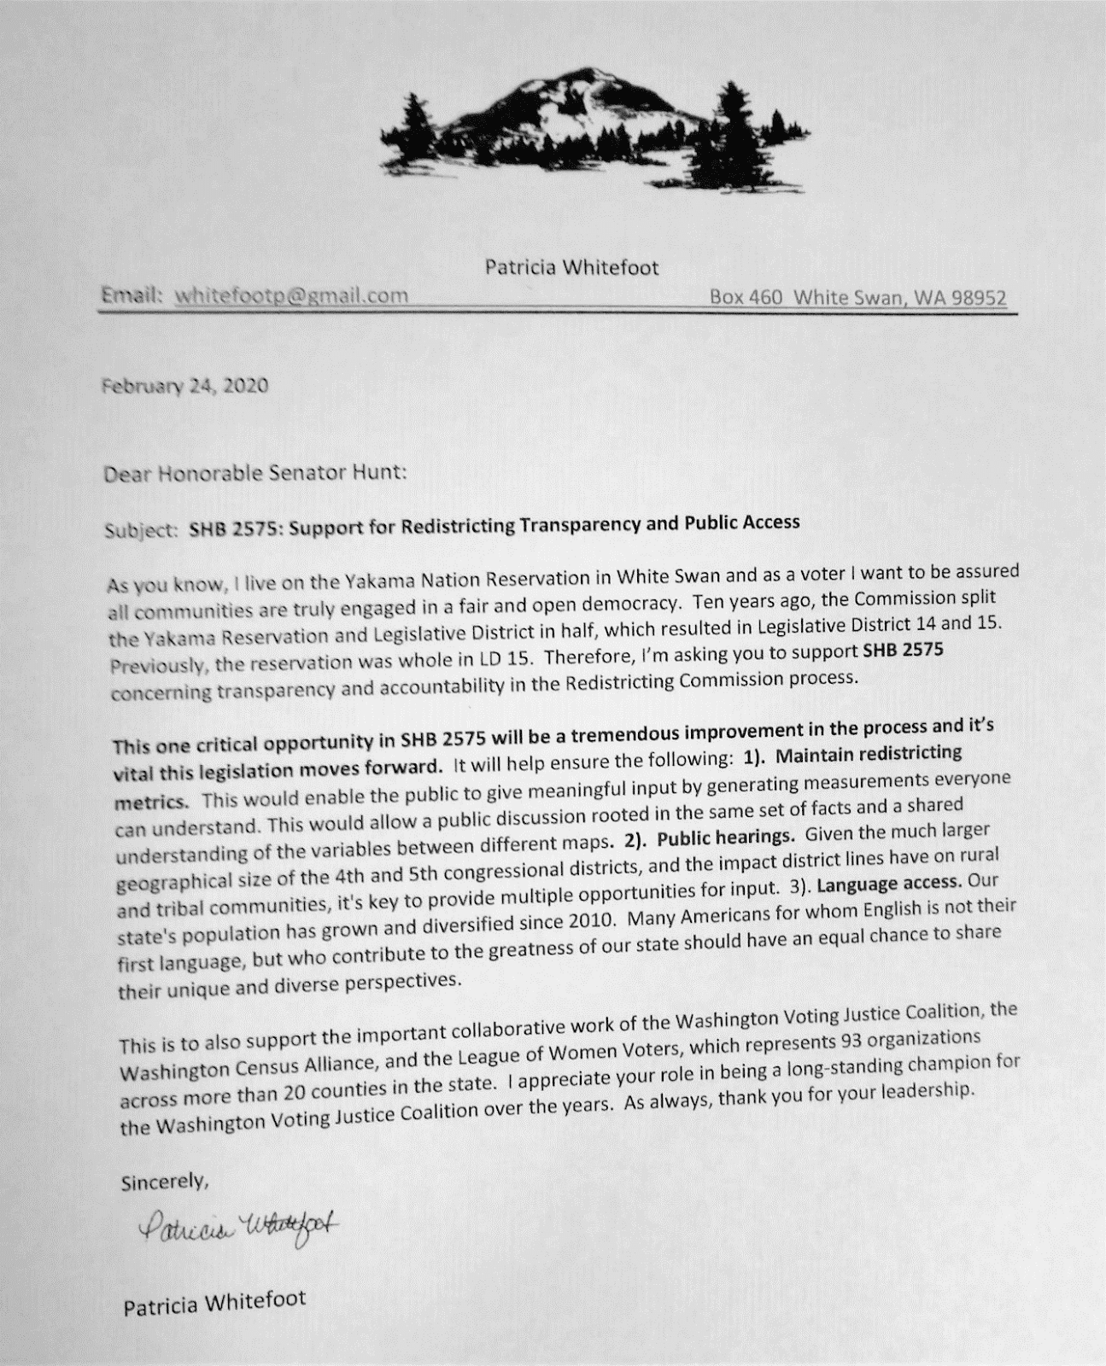
Preparing your Testimony:
What is “TESTIMONY”?
Letter contains:
Information on writer
What s/he is asking for his/her issue
Reasons/facts for his/her position
Created by
Notes:
This is an example of a written testimony submitted by Patsy Whitefoot, an esteemed elder of the Yakima Nation with significant experience in participating on national advisory boards. Patsy was writing to Wa State Senator Sam Hunt asking for his support in enhancing the Redistricting Commission law in WA.

Slide 14
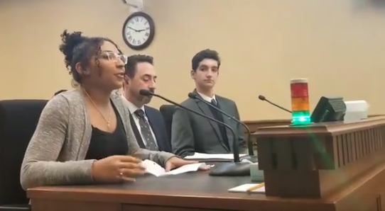
“Hello committee, my name is _____. I’ve been a resident of this neighborhood for 5 years. I’m here with a group of my neighbors and the neighborhood coalition. I would like to urge the committee to keep my community together.”
Preparing your Testimony:
Key Parts
Introduce yourself, your organization, any coalitions you work with!
Be clear on your goals for your testimony and community letting the commission know why you are there
Tell your story
Ask for a specific solution
Use your notes, if necessary
Created by
Notes:
All prepared testimony starts with an introduction. This is your way of describing yourself and the organizations or communities you represent. During the introduction you should make sure to address what your goals are in this redistricting process, what a good map that keeps your community together looks like- or what a map that takes into account a broader coalition could look like.

Slide 15
As you can see on community interest map for Riverside South, Alman Park is where our families gather to celebrate. Our community is currently divided into 2 city council districts and represented by two city council members.”
Preparing your Testimony:
Define your community
Define the unique qualities of your community
Highlight the geographic or structural boundaries in your neighborhood
Share and explain your COI mapping
Created by
Notes:
During your testimony, either written or in-person, it will be important to define your community and elaborate support or opposition on a proposed map.
When we talk about defining communities for a map, we mean what are the descriptions of your community and how are people connected. These could be addressed by answering questions like those on the screen- what makes your neighborhood unique and why is that unique-ness an important factor that should not be separated. Does your community have holidays or events that are specific to the neighborhood or create a border?
In section 2- Common Cause highlighted the story from Watts in which a community faced extreme environmental challenges and did not have relationships with their electeds since the community was divided into three districts.
After addressing these question, explain your COI map and the boundaries and gathering places that define the neighborhood map
Questions to consider addressing when presenting your COI map:
What are the streets or boundaries that mark your community borders on each side?
What are the significant landmarks: rivers, parks, shopping areas, or historic sites, etc.?
What are the gathering places: shopping districts, schools, community centers, religious places, and social service agencies?
Do the current political district boundaries divide your community? Or do they keep your community together?

Slide 16
Be PREPARED for
COUNTER ARGUMENTS
You might be questioned. Know if there are opposing viewpoints and be able to defend your position.
If you don’t know the answer to a question, say you “don’t know” but you will get back to them with the answer.
Created by
Notes:
It is unlikely, but might happen that a Commissioner will have a question for you or raise a point that is counter to your arguments.
If possible, know in advance what the issues are – for example, the pros and cons of
grouping low income voters into one district.
If you are asked a question that you don’t have an answer for, just acknowledge that “you don’t know” and then offer to get back to them with the answer.

Slide 17
Remember:
Create Stories with the ‘3 Cs’
Listen for stories that cover the 3 Cs:​
CULTURE: How would you describe the people who are part of your community? What do we have in common? What is our history? What are our languages? What do we celebrate? What do we value?​
CONCERNS: What issues need attention from government? What community projects need resources? Are there examples of elected officials ignoring our concerns? ​
COUNT: Is there data we can present that strengthens our stories? (Number of people in our community, % POC, income levels, distance from hospitals, lack of greenspace)​
Created by
Notes:
Section 2 of this training provided information on community mapping. We established that effective community stories include what has been coined ‘the 3 Cs’ of communication. These closely follow the components of effective testimony on the previous slide.
Culture (which is the many things that add up to the character of that community) (CLICK FORWARD)​
​
Concerns (issues that require attention from the government that might need more resources or attention) (CLICK FORWARD)​
​
Count (data that can strengthen the narrative we are telling about our communities).

Slide 18
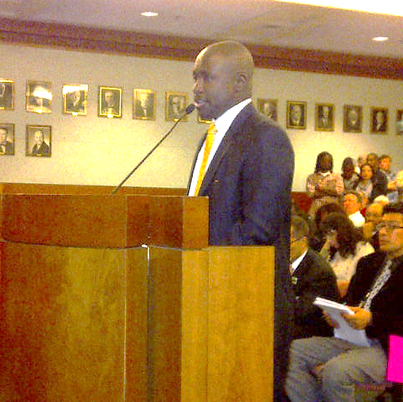
Preparing your Testimony:
Tips to Consider
Understand the process and rules- including virtual options
Public testimony should include quantitative and qualitative evidence
Make your testimony personal and community-centered
Share what negative outcomes could happen if maps change or remain the same
Aim for large community turnout to support testimony
Be concise and courteous!
Notes:
Wrapping up the testimony section, these are some main takeaways.
It will be important for advocates to understand the specific rules and process in their state or locality. If you’re organizing virtual testimony
From the data hub: https://docs.google.com/document/d/1WSVoVG8FwwUhbKGjhOgQqQ2JTZWNj9KHiLKFEXVLco4/edit

Slide 19
Testimony Breakout:
Public Testimony Role-Play
Based on the testimony role-play scenario, what went well?
Do you think Ms. Kindred’s points were well conveyed? How could they be improved?
Have people created testimony for redistricting already? What are some helpful real-world things to keep in mind?
Breakout groups will have 20 minutes to discuss questions in small groups before we return to the main room to share reflections and hear the final video
Created by
Notes:
Breakout- lead with weaker testimony; share what could be improved and then reconvene to share the good testimony with some state feedback.
Examples of testimony from states:
https://democracync.org/take-action/fairmaps/

