Slide 1
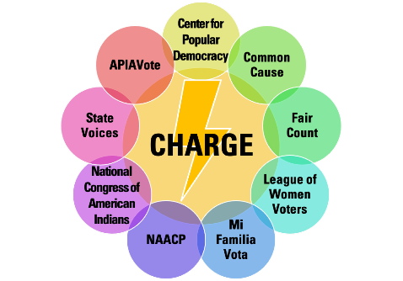
m
Redistricting Rules & Timelines
Notes:
Introduce yourself

Slide 2
Redistricting Community College
Curriculum
Part 1. Introduction to Redistricting What is Redistricting? How does it work? Why should we care?
Part 2. Voting Rights Act What is the Voting Rights Act? How does it protect minority communities?
Part 3A. Community Mapping – Training for Trainers Why is community mapping important? How do we define our community? What stories are we looking for? What data would help? Breakout - Learning to use the free community mapping apps How do we use the free mapping apps? What are the features? How do we share maps in a coalition?
Part 4. Redistricting Timelines and Rules
Part 5. Redistricting Advocacy: Improving Transparency and Providing Testimony How do we advocate, in virtual and in-person settings, for more transparent and inclusive procedures? How do we give effective testimony? Breakout – Crafting Testimony What makes effective testimony?
Part 6. Redistricting Coalition Building and Organizing How do we do a power analysis? How do we build strong coalitions? What are effective organizing strategies to build power? Breakout – Crafting a Power Analysis How to build coalitions and reach communities
Notes:
This is Part 4 of the 6 part Redistricting Community College curriculum. We are now going to quickly go through some of the redistricting rules and timelines that you should keep in mind as you prepare to participate in redistricting.

Slide 3
Redistricting Rules & Timeline: What you will learn
What are important questions to know about the redistricting rules?
What are the redistricting rules?
What is the redistricting timeline??
Notes:
Our conversation today will be in two parts. First, I'm going to talk about what the important questions are to ask when you're doing research or preparing to submit testimony during the redistricting process.
Next, my colleague Suzanne will walk us through the redistricting timeline – what to expect and when to expect it and take a deeper dive into two states. Please keep in mind that this is not all the information you will need. We'll make sure to share where you can find more information at the end of this presentation.

Slide 4
Redistricting Rules & Timeline:
What do we need to know?
To get started, you will want to have a conversation about:
What level of redistricting do we want to be involved in – congress? state? county? city? School board?
How do we submit a map of our community?
Do we also want to submit a map for a district? Or all the districts? How do we do that? What are the mapping criteria?
Created by
Notes:
One of the first questions you will need to think about with your group is – what level of government redistricting do we want to be involved in?
The level that you hear about in the news is most often congressional redistricting of the House of Representatives.
You may also want to think about how the state legislature’s lines are drawn.
At the county level, these elected representatives – often called boards of supervisors or judges – they may make decisions about major social services including health and sheriff departments.
At the city level, you may be interested in how the city council, or wards are drawn.
And don’t forget school boards – which are often times the first place that a community that have traditionally been left out can have an impact on electing candidates.
CLICK FORWARD
You will also want to thinking about whether you want to get involved in submitting testimony and maps about you community.
CLICK FORWARD
Are you trying to do more, and try to draw a map of a proposed district? Or even a map of all the districts in the state / county / city, etc.
To learn how to evaluate and even draw districts, we will be sharing some more advanced trainings at the end of this session that you can attend.

Slide 5
Redistricting Rules & Timeline:
What do we need to know?
Find out how to give input:
Who makes the mapping decisions?
When are public hearings?
How do we submit information? By email, through a web portal, in person?
Created by
Notes:
Each level of government may have different rules for who draws the lines, how a community can participate, and what the timeline is.
We have some information about each state’s timelines and rules for drawing its congressional and state legislative districts.
These are the key questions you will want to ask for any level of redistricting you decide to get involved in:
Who makes the mapping decisions?
When are public hearings?
How do we submit information? By email, through a web portal, in person?

Slide 6
Redistricting Timeline: Timeline Overview
Apportm’t data
4.26.21
Legacy
Redistricting data
8.15.21
Redistricting data
9.30.21
Mad scramble to draw district lines
Feb 21 | Mar21 | Apr 21 | May 21 | Jun21 | Jul 21 | Aug 21 | Sep 21 | Oct21 | Nov 21 | Dec 21 | Jan22 | Feb22 | Mar22 | Apr 22 | May 22 | Jun22
What is Apportionment Data?
Census 2020 data of each state's population
What is Legacy Data?
Raw Census 2020 data used for redistricting
What is Redistricting Data?
Census 2020 data that has been sorted into census blocks
Created by
Notes:
Now that we’ve learned about

Slide 7
Redistricting & Election Deadlines
Impacted by Adjusted Census Schedule
Redistricting Timeline:
How do timeline changes impact redistricting?

Slide 8
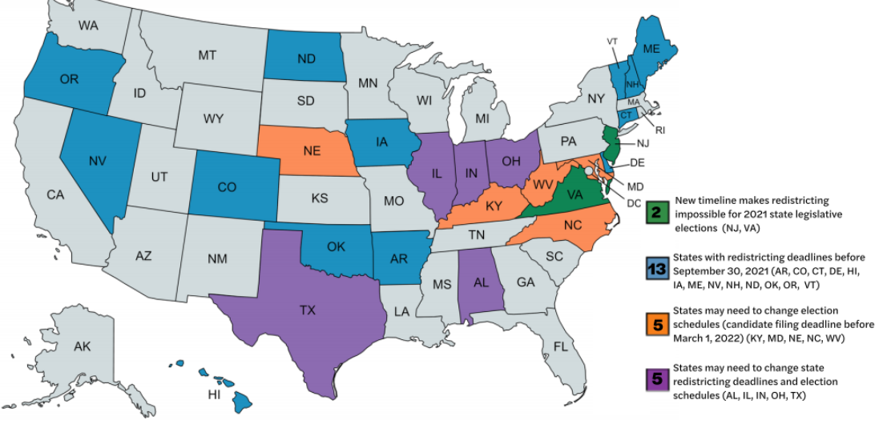
Redistricting Rules:
How is my state impacted?
Notes:
This is another way to look at the information in the previous slide.
-The states in green (NJ and VA) are using existing district lines for 2021 elections and will redraw in 2022.
- The states in blue are states with redistricting deadlines before Sept. 30
- the states in orange may need to adjust their election schedules to account for the change in data delivery dates
- the states may need to change state redistricting deadlines

Slide 9
Redistricting Rules: California Timeline
Apportm’t data
4.30.21
Redistricting data
9.30.21
Commission adopts
Congress & State maps
2.14.22
Candidate Filing
3.11.22
Primary Election
6.7.22
Raw
Redistricting data
8.15.21
Feb 21 | Mar21 | Apr 21 | May 21 | Jun21 | Jul 21 | Aug 21 | Sep 21 | Oct21 | Nov 21 | Dec 21 | Jan22 | Feb22 | Mar22 | Apr 22 | May 22 | Jun22
At least 5 months
May – Sep:
Public hearings to take
communities of interest testimony
Proposed 4 months
Oct - Jan:
Process data, present
drafts, hold hearings,
Adopt final maps
Court Review
&
County Process
Created by

Slide 10
Redistricting Rules: California Rules
Who draws the lines?
Congressional lines are drawn by an independent redistricting commission
State legislative lines are drawn by an independent redistricting commission
Created by
Notes:
https://redistricting.lls.edu/state/arizona/?cycle=2020&level=Congress&startdate=

Slide 11
Redistricting Rules: California Rules
What are the mapping rules?
Federal equal population requirements and adherence to the Voting Rights Act and constitutional rules on race
Adjust data to count incarcerated individuals at last known residence (Cal. Elec. Code § 21003)
Districts must be drawn with these criteria in priority order (Cal. Const. art. XXI, § 2(d)):
Population equality unless required to comply with VRA or law
Districts must be contiguous
As possible, preserving geographic integrities of existing jurisdictions and communities of interest
When possible, encourage compactness
Nesting: where possible, CA Assembly and CA Senate districts must be nested, with two Assembly seats in each state Senate seat
Created by
Notes:
https://redistricting.lls.edu/state/arizona/?cycle=2020&level=Congress&startdate=

Slide 12
Redistricting Rules: Georgia
Created by
Apportm’t data
4.30.21
Raw
Redistricting data
8.15.21
Redistricting data
9.30.21
3.11.22
Candidate
Filing
5.24.22
Primary Election
Mar21 | Apr 21 | May 21 | Jun21 | Jul 21 | Aug 21 | Sep 21 | Oct21 | Nov 21 | Dec 21 | Jan22 | Feb22 | Mar22 | Apr 22 | May 22 | Jun 22 | Jun22
At least 5 months:
Public hearings to take communities
of interest testimony
Approx. 4 months:
Process census data, display draft maps, hold hearings, complete maps
Court & County Prep
Notes:
You can see on the screen the timeline for GA.

Slide 13
Redistricting Rules: Georgia Rules
Created by
What are the mapping rules?
Federal equal population requirements and adherence to the Voting Rights Act and constitutional rules on race
Contiguity: all state legislative districts must be contiguous (Ga. Const. Art. III, § II, ¶ 2)
Notes:
https://redistricting.lls.edu/
Very few rules...

Slide 14
Redistricting Rules: Georgia Rules
Created by
Who draws the lines?
Congressional lines are drawn by the state legislature as a statute and is subject to a gubernatorial veto
State legislative lines are drawn by the state legislature as a statute and is subject to a gubernatorial veto
Notes:
https://redistricting.lls.edu/

Slide 15
m
For more in on Redistricting Rules & Timelines, check out:
www.redistrictingcommunitycollege.com
www.commoncause.org/redistrictingtimelines

