Slide 1
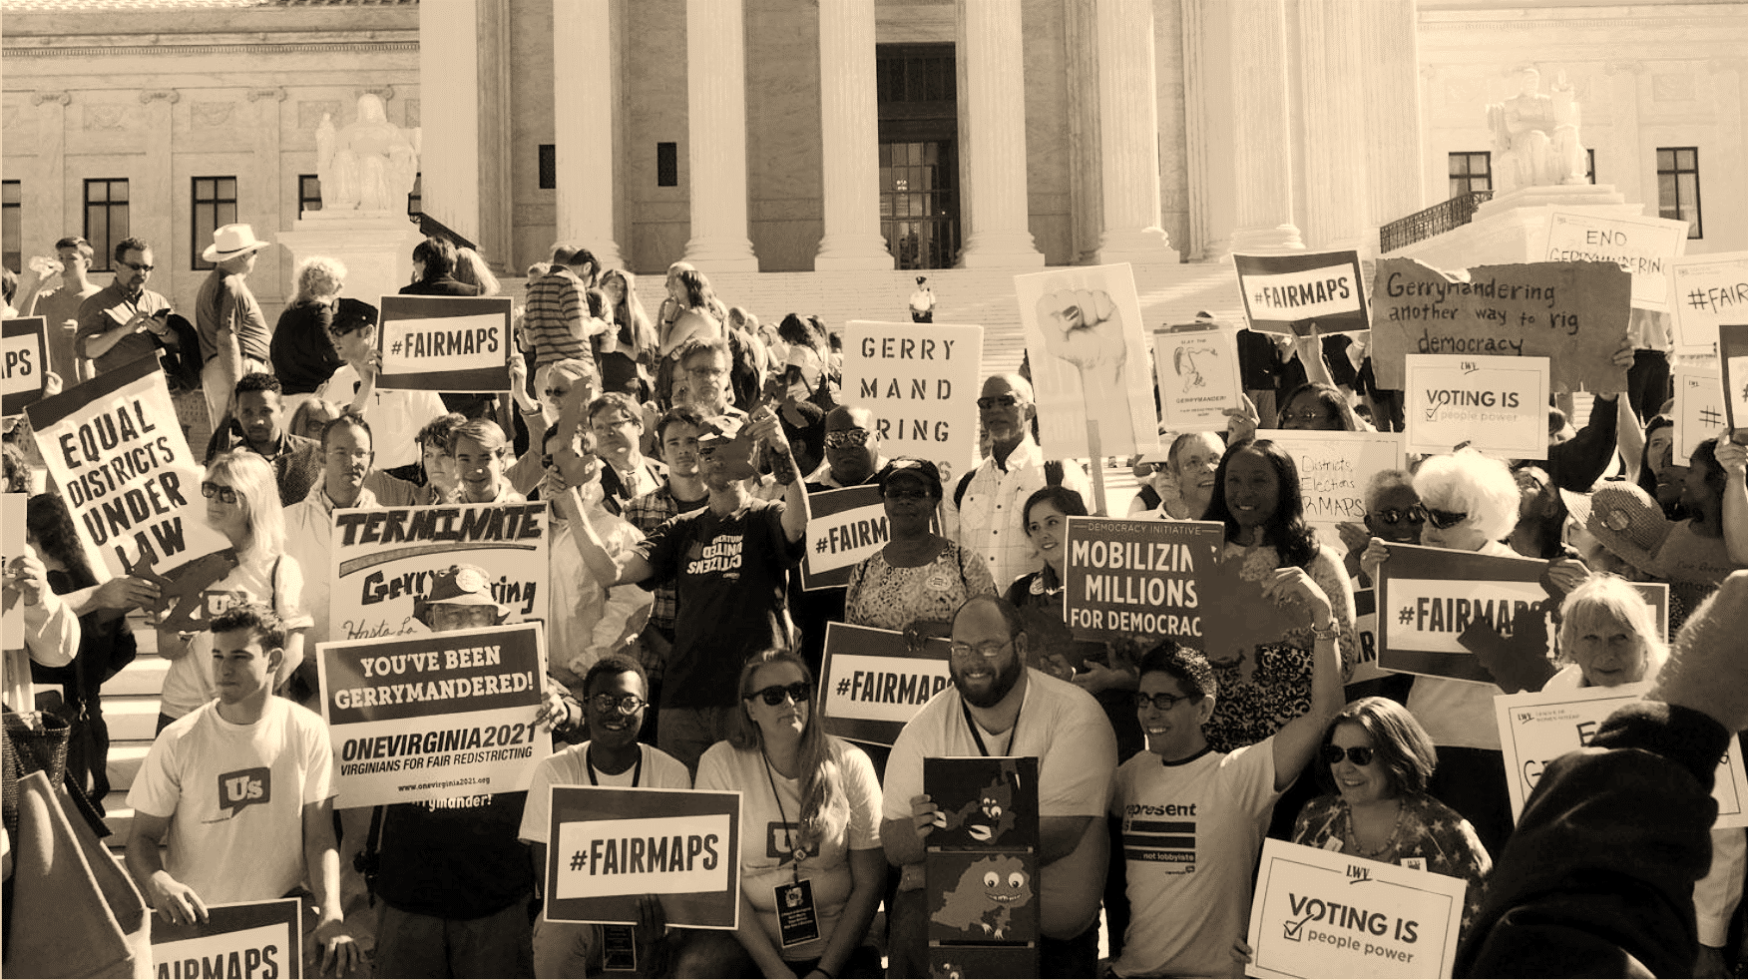
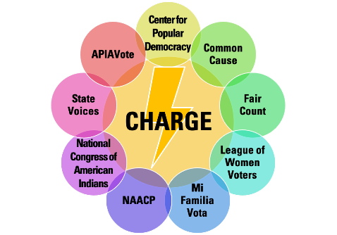
Mapping Our Communities
Community Workshop
Notes:
Introduce yourself

Slide 2
What is redistricting?
Introduction: What is redistricting?
5
5
Redistricting is when we redraw districts so each has the same number of residents.
5
5
Notes:
What is Redistricting? Redistricting is when we redraw districts so that each district has the same number of residents.
The United States Constitution requires that political districts of the same type have the same number of residents. This is called the principle of population equality. The goal of population equality is to make sure that each legislator represents the same number of people. Let’s say we have a city with 20 people. There are 4 council districts. 20 divided by 4 is 5, so you are aiming to have 5 people in each district to have population equality.
This is true for districts at all levels of government, including congressional districts, state districts, and local districts.
[Hit right arrow once to trigger animation.]
Here we have a very simple example of four districts. Each district has five people each – so each elected official represents the same number of people.
Worksheet references: Redistricting overview

Slide 3
What is redistricting?
Introduction: What is redistricting?
Over time, districts become uneven in size.
5
8
4
7
Notes:
Over time, people move. Children are born, people pass away. This means some places have population growth, and other have decreases in population. For example, in times of economic crisis, people may move to places where rent and housing prices are cheaper.
Because of this, districts become uneven in size during the course of a decade.
[Hit right arrow once to trigger first animation.]
[Hit right arrow again to trigger second animation.]
[Hit right arrow one last time to trigger third and final animation.]
In this example, the two districts on the right now contain more people than the two districts on the left.

Slide 4
What is redistricting?
Introduction: What is redistricting?
Every ten years, we count people again, and then redraw the district lines to have an even number of people again.
6
6
6
6
Notes:
Every ten years, the federal government counts everyone in the country – this is called the census.
After the census is finished, district boundaries must be redrawn to even out the size of each district – this is called redistricting, and it happens at all levels of government.
In New Mexico, the district boundaries are redrawn for Congress, the State Legislature, county boards, city councils, and school boards.
This process of drawing new district maps is based on the census data.
In our City, the population grew from 20 to 24 in the last 10 years. It did not grow evenly, so new district lines have to be drawn (purple) replacing the old ones (blue dotted lines). With the new lines, each district now contains six people.
*PAUSE FOR QUESTIONS*

Slide 5
Introduction: Why does redistricting matter?
Redistricting can take away minority voting rights.
Minorities make up only
¼ of each district
Notes:
For better or for worse, different segments of our population have differing political views. These political views are often correlated with one’s party affiliation. These views are also frequently correlated with social and economic characteristics, as well as geographic location.
For example, racial and ethnic minorities often have viewpoints on which candidates will best represent them that are different from other populations.
Where there are these differences in viewpoints, the way district maps are drawn affects whether racial and ethnic minorities have the ability to elect candidates of their choice, or at least influence the outcome of elections.
In this example, a racial minority population makes up one-fourth of this area’s population.
[Hit right arrow once to trigger first animation.] If we draw the district lines this way, there are four districts, and the minority population makes up only one-fourth of each district.
[Hit right arrow again to trigger second animation.] Chances are that the minority population will not have much of a say in how elections are determined in any of these districts, even though the minority population makes up one-fourth of the area’s entire population. There’s also a strong possibility that none of the elected representatives from these districts will be especially responsive to the needs of the minority population – the elected representatives don’t have to rely on the minority population to get re-elected, and have less incentive to pay attention to them.
This same dynamic plays out with any group that is a political minority – for example, Democrats in heavily Republican areas, Republicans in heavily Democratic areas, and other groups that are politically cohesive, but have views different from those of the majority population.

Slide 6
Why does redistricting matter?
Introduction: Why does redistricting matter?
When we organize, we can elect candidates of our community’s choice.
Minorities make up
a majority of this district
If a majority can be drawn, the Voting Rights Act
may require it
Notes:
But things could be different if we draw the district lines another way.
[Hit right arrow once to trigger first animation.] Here the minority population makes up over three-quarters of the population in the middle district.
Chances are that the minority population will have a significant influence on the outcome of elections in this district. The minority population in this district is also in a stronger position to lobby their representative to meet their needs. This is in contrast to the districts in the previous slide, where the minority population had little influence in any of the four districts.
In the past couple of slides, I’ve simplified the process of drawing district maps. There are other rules for how the maps must be drawn. One of these is the federal Voting Rights Act, which may provide protection for racial and ethnic minorities in a situation like this one.
The Voting Rights Act is critical to ensuring that racial and ethnic minority communities have an opportunity to elect candidates of their choice. The decision makers will have an important role in determining whether the next set of district maps comply with the requirements of the Voting Rights Act.

Slide 7
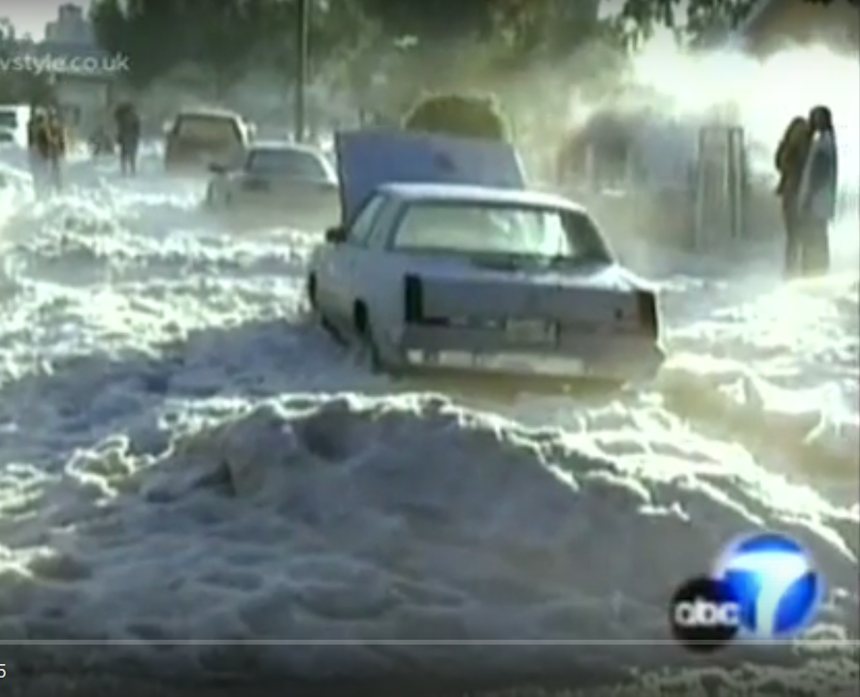
Take a guess where this picture is from
Created by
Notes:
Let's move from a hypothethical district to a real one.
(Allow people to guess.)
Answer: This is in Watts, a neighborhood of Los Angeles that was historically Black and has a large growing Latino population. This community is in Southern California and is not built to handle

Slide 8
In a time of need, Watts was ignored.
Created by
Notes:
On November 12, 2003, a freak storm dumped over 5 inches of rain and hail on Watts, overwhelming storm drains and flooding the community. About 150 buildings and homes were heavily damaged, 50,000 people lost power, and 6,000 people sought aid from the county’s emergency center. Firefighters rescued about 100 people from waistdeep water and snow.
Many people had lost everything; mattresses, clothes, cars, even refrigerators. However, the government was slow to aid the people. FEMA refused to act when then-Governor Gray Davis declared a state of emergency (six days after the flood). -- Redistricting played a role in that.

Slide 9
In 2001, Watts was split by incumbents into 3 districts at the Congressional level.
Why?
Because Watts neighborhood was split by district lines.
Created by
Notes:
In 2001, Watts was split by incumbents into three districts at the congressional and state senate level.
(Here, Watts is the community shaded green. The congressional lines are red, and you can see how they cut Watts into three pieces).

Slide 10
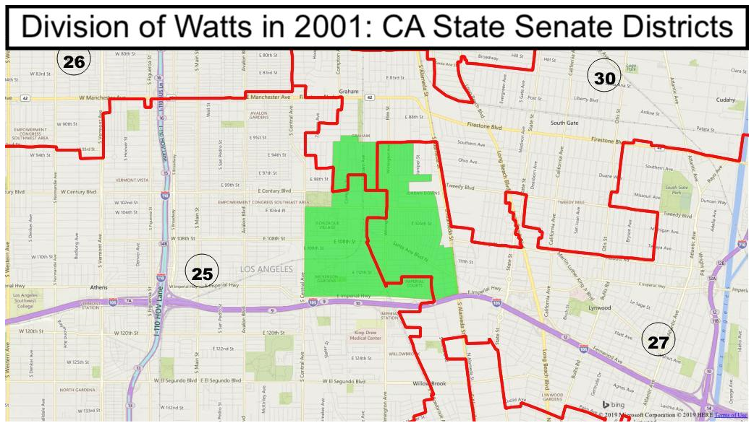
In 2001, Watts was split by incumbents into 3 districts at the state Senate level.
Watts had no political voice because it was split.
Created by
Notes:
Watts was even split into three state Senate districts. No wonder they could not get representation.

Slide 11
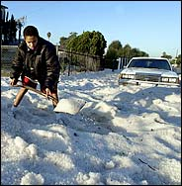
How redistricting without community voices hurts
“At the time of the 2003 flood, I remember our office trying to be very responsive, but there was a lot of ping-ponging of constituents between elected representatives. Residents weren't sure who actually was their member of Congress.
Watts is cut into three different Congressional and state Senate districts. Residents who live on the same street may live in different districts. There was a lot of unnecessary frustration for constituents during a difficult time.
This would have never happened if all of Watts belonged to one district.”
- Romulo Rivera, former Congressional staffer
Community
voices and needs were abandoned.
Created by
Notes:
As this quote from a former congressional staffer indicates, Watts residents struggled to get the attention of elected officials because none of them felt responsible for the care of that community.
[read some portion of the quote]
“This would have never happened if Watts belonged to one district.”

Slide 12
After 2011, the community united to testify about Watts before the CA Citizens Commission.
Watts was made whole.
Organizing our communities can ensure our voices are heard
Notes:
After 2011, after leaders united to testify about Watts before the CA Citizens Commission, Watts was made whole. (P.S. the new 44th congressional district elected Nanette Barragán, the first Latina ever to represent this district in 2012).

Slide 13
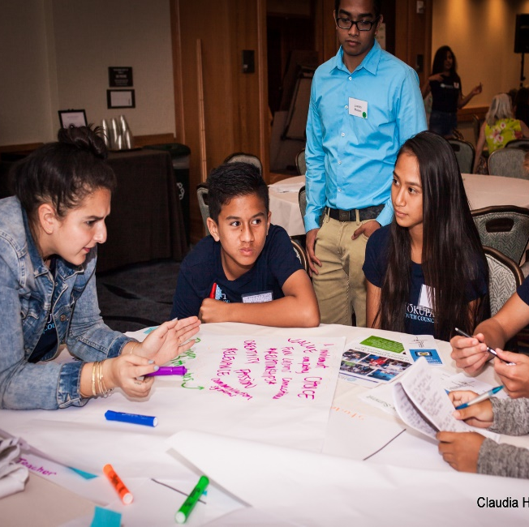
Community Mapping:
How do we organize to put our community on the map?
Let’s think about these questions:
Who should be at the table to describe our community?
Are there other folks we want to invite?
What level of redistricting do we want to be involved in – congress? state? county? city? School board?
Do we want to submit a map of our community?
Who are possible allies we want to reach out to increase our power?

Slide 14
Redistricting Timeline:
Apportm’t data
4.26.21
Legacy
Redistricting data
8.15.21
Redistricting data
9.30.21
Mad scramble to draw district lines
Feb 21 | Mar21 | Apr 21 | May 21 | Jun21 | Jul 21 | Aug 21 | Sep 21 | Oct21 | Nov 21 | Dec 21 | Jan22 | Feb22 | Mar22 | Apr 22 | May 22 | Jun22
What is Apportionment Data?
Census 2020 data of each state's population
What is Legacy Data?
Raw Census 2020 data used for redistricting
What is Redistricting Data?
Census 2020 data that has been sorted into census blocks
Kathay Feng – kfeng@commoncause.org
Notes:
Redistricting starts when the Census bureau delivers the data for redistricting. Right now, there are court and congressional actions taking place that may give the Census more time to keep counting. Census data for redistricting will be released in 2021, but we don’t know yet whether that will be by March or July 31, 2021.

Slide 15
Community Mapping: What is it?
Community mapping = when a group of people identify:
WHO we are
WHAT makes us special
WHERE we live
HOW we share interests
WHO we are
WHAT makes us special
WHERE we live
HOW we share interests
Created by
Notes:
The easiest way to think of Community Mapping is to start with these 4 basic questions.
WHO we are
WHAT makes us special
WHERE we live
HOW we share interests

Slide 16
Communities of Interest: Legal definition
Community of Interest is a neighborhood or area whose residents have shared culture, history, and policy concerns and so would benefit from being represented in the same district.
Kathay Feng – kfeng@commoncause.org
Created by
Notes:
Let's start the conversation about putting our community on the map!
“Communities of interest” is a legal term in redistricting. "A Community of Interest is a neighborhood or area whose residents have shared culture, history, and policy concerns and so would benefit from being represented in the same."
Traditionally, no one has bothered to ask people who live in each community or neighborhood what binds your community together. Often, redistricting is done in a top-down way. But the conversation and tools we will go through today with give YOU the power to define your own community!
Keeping communities together gives us a stronger voice in government!
Down to the street level, you can tell those who draw our districts what landmarks, streets, shopping areas, transportation routes, parks and rec centers, places of worship, and other places make up your community. Mapmakers can only keep your community together if they know where you are. Shortly, we’ll have Dan open up Districtr so we can get started.
[Tie legal definition to what we are doing here.]

Slide 17
Community Mapping: Things to think about
Share stories that cover the 3 Cs:
CULTURE: How would you describe the people who are part of your community? What do we have in common? What is our history? What are our languages? What do we celebrate? What do we value?
CONCERNS: What issues need attention from government? What community projects need resources? Are there examples of elected officials ignoring our concerns?
COUNT: Is there data we can present that strengthens our stories? (Number of people in our community, % POC, income levels, distance from hospitals, lack of greenspace)
Created by
Notes:
The facilitator will play a key role in keeping the discussion going by listening for and steering the discussion toward identifying the three Cs:
Culture (which is the many things that add up to the character of that community) (CLICK FORWARD)
Concerns (issues that require attention from the government that might need more resources or attention) (CLICK FORWARD)
Count (data that can strengthen the narrative we are telling about our communities).
Refer to materials, page ….
Be ready for a VRA question that may come up.

Slide 18
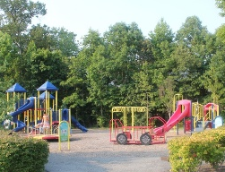
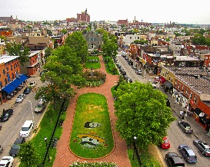
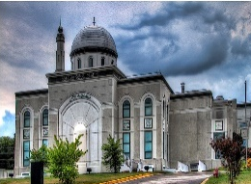
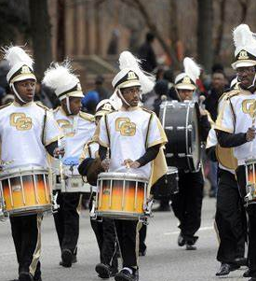
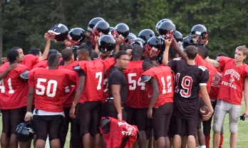
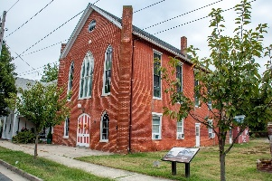
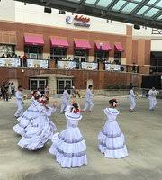
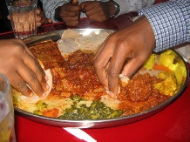
Communities: Telling our stories
Go around the room.
Please share...
Your name
The name of your community
Share one thing you love about your community
Eg: My name is Suzanne and I live in Harrisburg, in the Midtown Harrisburg neighborhood. One thing I love is my easy access to the Broad Street Farmer’s Market.
Kathay Feng – kfeng@commoncause.org
Created by
Notes:
(This is about 5 minutes)
Facilitator: if you are presenting in a place that you are not familiar with, we suggest you start with some Googling to find neighborhoods and community place names to learn.
"Let's start with a little ice breaker. Can we go around the room/zoom, and introduce yourself? What is your name and the name of your community or neighborhood? Share one thing you love about your community….
As people are going around, make notes about the places that people are mentioning.
After participants go around introduce themselves, the group will need to agree to focus on a place that they will work on. If there is more than one neighborhood, set up an order to tackle additional places, after you finish the first.
**Prepare for Eager Earl to ask about how to draw district lines. We will prep an FAQ to answer their questions. Find ways to bring it back to the community convo.

Slide 19
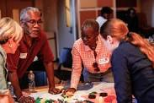
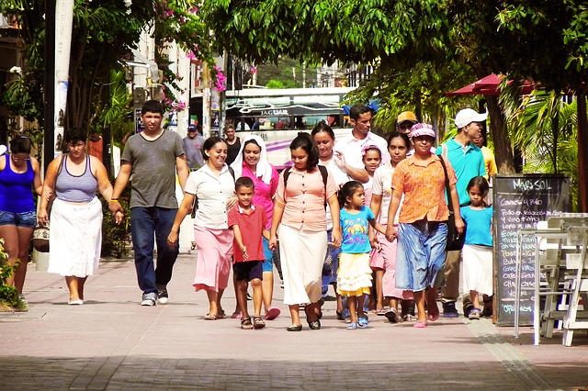
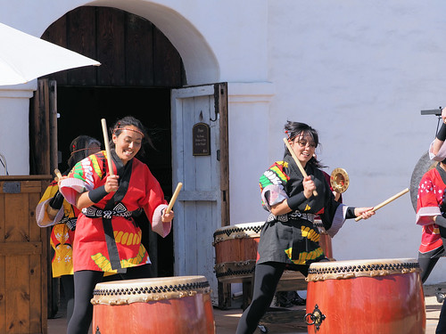
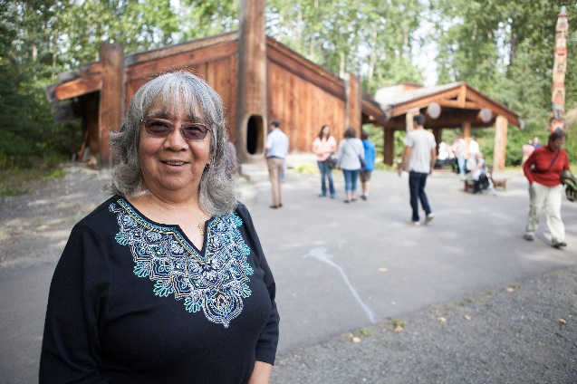
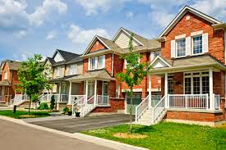
Communities: Telling our stories
Take a minute
to write down a description of your community or neighborhood.
How would you describe your community to someone who is thinking about moving there?
You can use the Chat box to share!
Created by
Notes:
(8-10 Minute discussion)
Facilitator:
“I’d like you think about what story you would tell about your community. Imagine you are describing your community to someone who is thinking about moving there. How would you describe the people who live there? Does your community have special traditions or celebrations? What makes your community unique from other communities?”
"I want you to type your description into the chatbox."
Give directions on how to find the chat box. Make sure people have it open.
“Let’s take a minute for each person to type out a description of your community in the chatbox. Your time starts now.”
(Keep track of 1 minute. At about 45 seconds, tell people to finish up soon.)
“Great, I see that everyone has typed their descriptions in the Chatbox. Let’s come back together to discuss some of the description that may be in common. Let’s go around the Zoom and read the descriptions. Do we have a volunteer to start?”
(Facilitator – take notes in two columns – One for places (or events that occur in a particular place), and one for community characteristics. You will use the “Places” list for the next slide. Feel free to tease out some of the events or characteristics that might be associated with a place. EG: Suzanne, you mentioned a Farmer’s Market – does that always occur in the same place?)
Prepare for Eager Earl to ask about how to draw district lines. We will prep an FAQ to answer their questions. Find ways to bring it back to the community convo.

Slide 20
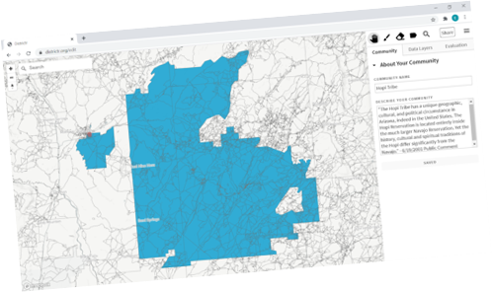
Communities: Let’s map our important places
Let’s use DistrictR.org to map important places!
What places have people already talked about?
Are there additional places that are important?
Let’s start by using DistrictR to mark important places on the map.
Let’s map the important places in your community
Kathay Feng – kfeng@commoncause.org
Created by
Notes:
(About 5-10 minutes of discussion. About 15 minutes of Marking Landmarks – spend no more than 5 minutes for each Landmark).
Facilitator: (Non-Tech-Savvy Group)
“I heard in our icebreaker, a number of places that people already mentioned…“ (Name them, eg: farmer’s market, XX bookstore, XX restaurant row, XX rec center.) “I also heard some additional places as you were describing your community…” (Name them places you heard)
“Let’s go to DistrictR.org and map (one of those places). Is there a place that people would like to start with? We can do a few.” (Identify one place to start with.)
(Log into Districtr.org. Narrate what you are doing as you get to the Community Page. Introduce them to the Hand / Pan Tool, and the Landmark Tool).
“Let’s start with the Landmark Tool”
Now that we have marked XXXX, let’s mark a few more important places (Landmarks).
Map additional places for 15 minutes
I know there are additional places that people may want to put on the map. Later, you can add more places on the map, when we share with you the group code.
Facilitator: (Tech-Savvy Group)
“I heard in our icebreaker, a number of places that people already mentioned…“ (Name them, eg: farmer’s market, XX bookstore, XX restaurant row, XX rec center.)
“I heard as you were describing XX community, some additional places…” (Name them)
I am going Map the Farmer’s Market. I want each you to try mapping another place.
Let’s map them.
Prepare for Eager Earl to ask about how to draw district lines. We will prep an FAQ to answer their questions. Find ways to bring it back to the community convo.

Slide 21
Communities: Let’s map our important places
Let’s map the important places in your community
If you have access to DistrictR.org or another mapping app, switch over here.
You can start to map by marking important places!
You can then go to shading in your community. Be sure to have good descriptions with details of Culture, Concerns, and Counts!
Kathay Feng – kfeng@commoncause.org
Created by
Notes:
(About 5-10 minutes of discussion. About 15 minutes of Marking Landmarks – spend no more than 5 minutes for each Landmark).
Facilitator: (Non-Tech-Savvy Group)
“I heard in our icebreaker, a number of places that people already mentioned…“ (Name them, eg: farmer’s market, XX bookstore, XX restaurant row, XX rec center.) “I also heard some additional places as you were describing your community…” (Name them places you heard)
“Let’s go to DistrictR.org and map (one of those places). Is there a place that people would like to start with? We can do a few.” (Identify one place to start with.)
(Log into Districtr.org. Narrate what you are doing as you get to the Community Page. Introduce them to the Hand / Pan Tool, and the Landmark Tool).
“Let’s start with the Landmark Tool”
Now that we have marked XXXX, let’s mark a few more important places (Landmarks).
Map additional places for 15 minutes
I know there are additional places that people may want to put on the map. Later, you can add more places on the map, when we share with you the group code.
Facilitator: (Tech-Savvy Group)
“I heard in our icebreaker, a number of places that people already mentioned…“ (Name them, eg: farmer’s market, XX bookstore, XX restaurant row, XX rec center.)
“I heard as you were describing XX community, some additional places…” (Name them)
I am going Map the Farmer’s Market. I want each you to try mapping another place.
Let’s map them.
Prepare for Eager Earl to ask about how to draw district lines. We will prep an FAQ to answer their questions. Find ways to bring it back to the community convo.

Slide 22
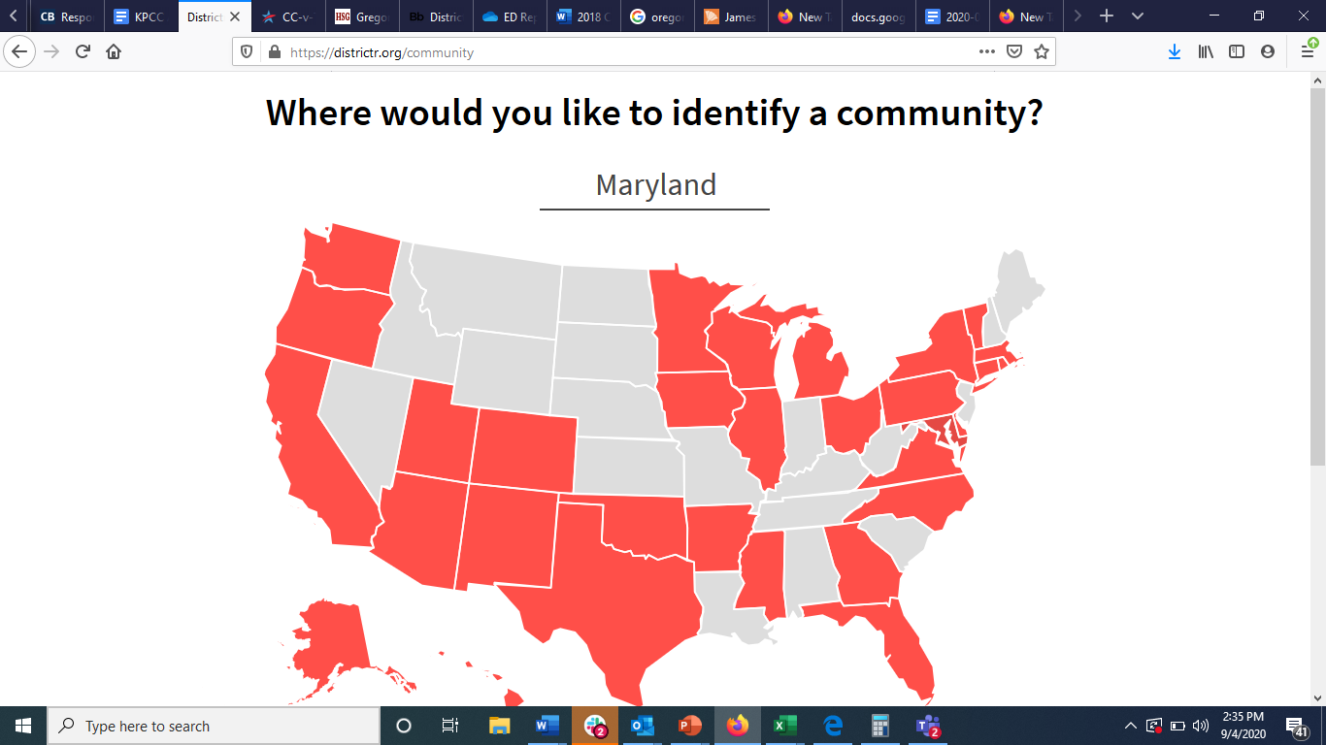
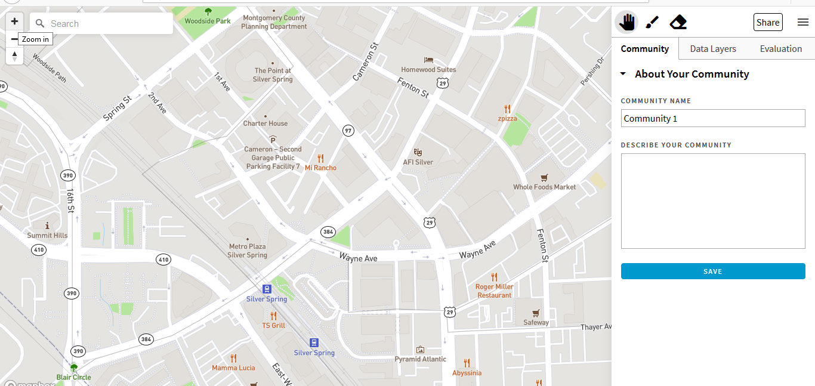
Go to DistrictR.org
Let’s use DistrictR to map important places!
Click on your state
Choose “Identify your community”
Zoom into your community
(Use the + button in the top left corner to zoom in)
(Hold the left mouse button down and place your cursor on the map to move the map)
Kathay Feng – kfeng@commoncause.org
Created by
Notes:
(: 10-12 minutes)
What to name each community.
Now that we have named it, let's put a description in. Ex: this is a community with a large Muslim community, in a suburb of Albuquerque. The community center on 8th ave. Is a central point of the community.
When you are ready to save your work. On the top right hand corner, you'll find a button a share button. The "share" button will give you your own unique url for the map you just drew.
Since you have a group here in NM that may want to keep meeting we are giving you your our own event code. Type that event code into the "have and event code" box. And click on "add to event" button.
This will create a saved copy of your map. If anyone in your group wants to add to it or make changes, as long as they enter the event code, each persons changes will be associated with the same map, even if changes are being added from different computers
EX: If Keshia wants to open the url and add her park and her favorite Orage Theory gym in, she can do that and Dan can add his favorite Kale smoothie place. Each person can map their places of interested on their own computers, but it will be uploaded to the same map, because everyone is using the same event code.
PAUSE – any have any questions

Slide 23
Free Community Mapping Apps
Currently, there are at least three free mapping apps that allow people to draw community maps:
DistrictR.org
Representable.org
Dave’s Redistricting App
Kathay Feng – kfeng@commoncause.org
Created by
Notes:
(Painting the community: 10-12 minutes)
Facilitator:
“We have now mapped a few of the important landmarks of our community, XXX. Let’s move to coloring in the shape of the community.“
(Show the group the Brush tool. “This is the Brush tool that we use to color in the blocks that we want to include in our community.”
“What I heard in the conversation is that XXX is an important place in the community. Can we agree that that is a part of the community that we can color in?” (If yes, then paint that place/block/precinct.)
(Move through the map and ask about other landmarks that you heard many people talk about). “I also heard some of you say is that XXX is an important place in the community. Can we agree that that is a part of the community that we can color in?” (Keep going until you have covered the most talked about places.)
(Move through the map and ask about other areas where there are landmarks, that are not included in the painted area. Let discussion guide you). “Are there other areas that we have not colored in yet that should be included? Is this area also a place we agree is part of the X community”
(Give about 10 mins for this section)

