Slide 1
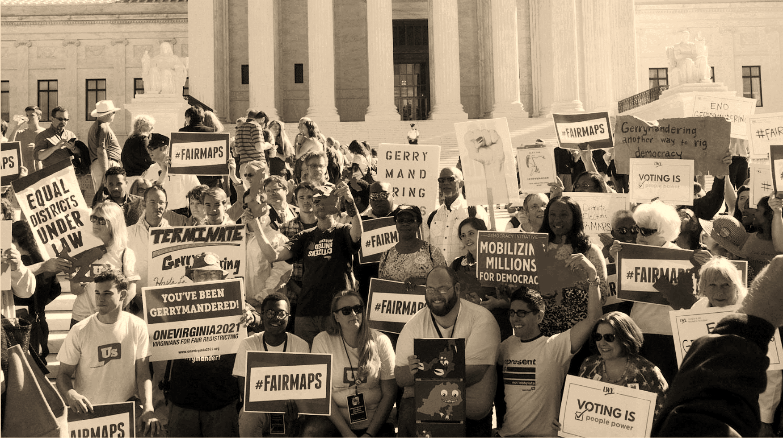
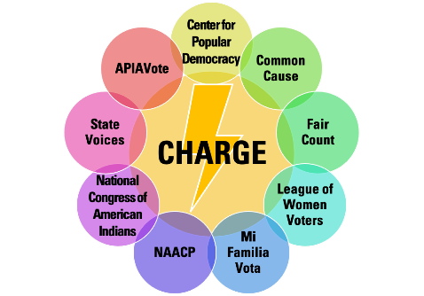
Mapping Our Communities
Training for Trainers
Notes:
Introduce yourself

Slide 2
Redistricting Community College
Curriculum
Part 1. Introduction to Redistricting What is Redistricting? How does it work? Why should we care?
Part 2. Voting Rights Act What is the Voting Rights Act? How does it protect minority communities?
Part 3A. Community Mapping – Training for Trainers Why is community mapping important? How do we define our community? What stories are we looking for? What data would help? Breakout - Learning to use the free community mapping apps How do we use the free mapping apps? What are the features? How do we share maps in a coalition?
Part 4. Redistricting Timelines and Rules
Part 5. Redistricting Advocacy: Improving Transparency and Providing Testimony How do we advocate, in virtual and in-person settings, for more transparent and inclusive procedures? How do we give effective testimony? Breakout – Crafting Testimony What makes effective testimony?
Part 6. Redistricting Coalition Building and Organizing How do we do a power analysis? How do we build strong coalitions? What are effective organizing strategies to build power? Breakout – Crafting a Power Analysis How to build coalitions and reach communities
Notes:
This is Part 3 of the 6-part curriculum in the Redistricting Community College.

Slide 3
Community Mapping: What you will learn
In this session, we will cover:
What is community mapping?
Why does community mapping matter?
How do we run a community mapping workshop?
After the presentation, we will have breakouts:
Practice community mapping
Learn to map or analyze your community on a free app:
DistrictR, Representable, or Dave’s Redistricting App
Notes:
In this session, we will cover:
- What is community mapping?
- Why does community mapping matter?
- How do we run a community mapping workshop?
CLICK FORWARD
Right after this presentation, you will have an opportunity to participate in a breakout session to practice mapping a community and learn about how to map using one of the free community mapping apps.

Slide 4
Community Mapping: What is it?
Community mapping = when a group of people identify:
WHO we are
WHAT makes us special
WHERE we live
HOW we share interests
Created by
Notes:
The easiest way to think of Community Mapping is to start with these 4 basic questions.
WHO we are
WHAT makes us special
WHERE we live
HOW we share interests

Slide 5
Community Mapping: What is it?
Community of Interest =
A neighborhood or area whose residents have shared culture, history and policy concerns and so would benefit from being represented in the same district.
Kathay Feng – kfeng@commoncause.org
Created by
Notes:
You will hear this term “Communities of interest” in redistricting – it is a legal term that you may see if state law or recognized by courts. "A Community of Interest is a neighborhood or area whose residents have shared culture, history, and policy concerns and would benefit from being represented in the same district."
Traditionally, no one has bothered to ask people who live in each community or neighborhood what binds your community together. Often, redistricting is done in a top-down way. But the conversation and tools we will go through today with give YOU the power to define your own community!
Keeping communities together gives us a stronger voice in government!

Slide 6
Community Mapping: What is it?
Community mapping
In redistricting, communities of interest share common Culture, Concerns, and Counts
The most powerful stories connect our identity with impact
We can start telling our stories and mapping our communities NOW
Created by
Notes:
Community Mapping is the first step of Redistricting. It starts with having local conversations about our communities, and what the Culture, Concerns and Counts are of each. We'll look for stories that connect community identity with impact. We can start this community mapping now, before the 2020 census data for redistricting is released. We can use American Community Survey data and free mapping apps to bolster the case we're making for each community.

Slide 7
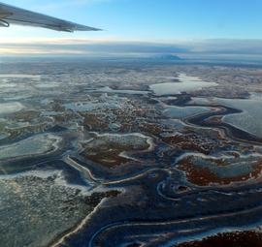
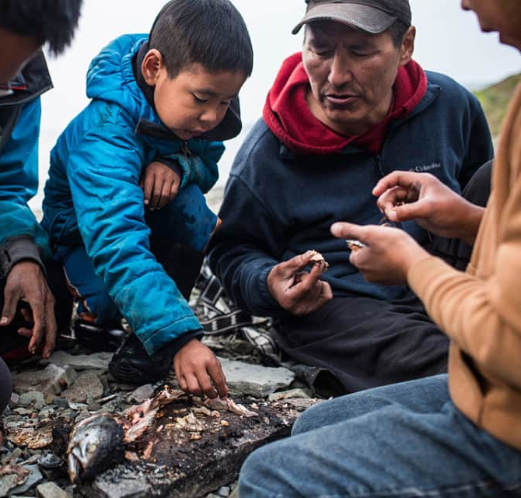
Community Mapping: What is it?
Example of Community Stories
“Calista has over 33,000 shareholders and was created to serve the Alaska Native people of the Yukon-Kuskokwim ("YK") Delta region of Western Alaska, an area that is home to 56 federally recognized Tribes and nearly one-quarter of all the Tribes in Alaska. YK Delta communities are located along the Yukon and Kuskokwim Rivers and the Bering Sea and spread across an area the size of New York State. Our communities are not connected to each other by road system and the only access to each community is by river ice road, frozen tundra, small watercraft during the short summer, or airplane. The only options to reach the rest of Alaska are by ship or airplane.” - Walter Featherly
Created by
Notes:
So what is community mapping? Let’s look an example of a community – this is Calista, in western Alaska.
(Look at the quote)
In this example, Walter Featherly talks about the identity of this Alaskan community of Calista. He describes the location of the community – in the Yukon-Kuskokwim Delta region ow Western Alaska. Walter also talks about challenges in community regarding barriers to transportation, sometimes only through river ice roads.

Slide 8
Community Mapping: Where does it fit into redistricting?
Community mapping
District mapping
Coalition building
District mapping follows US and state constitutional rules. (equal population, Voting Rights Act. May also include compactness, contiguity, keeping cities, counties and communities together)
District maps should be drawn using 2020 census data, down to the block level.
Created by
Notes:
How does Community Mapping fit into redistricting?
CLICK FORWARD
After many communities have mapped themselves, we will want to BUILD COALITIONS to work through where there are shared interests. There is always strength in numbers, so anytime we can, we should identify places where is there is agreement. We will also need to be aware of places where there is not agreement. Coalition building should be constant. It can be critical to overcoming political opposition. We should always ask who else needs to be at the table.
CLICK FORWARD
Last but not least, this all builds up to DISTRICT MAPPING. In most places, every level of government needs to be redistricted – from school boards to city councils to state legislatures and congress. We are focusing on teaching you how to map your communities. There are ally groups that will look at you have mapped your community, think about what coalitions are advocating for, and use all of that to draw district maps.
Mapping districts can be complicated because there are a lot of factors to take into consideration, like making sure the districts are close to their ideal population and making sure they comply with the Voting Rights Act where there are minority populations. State constitutions or local charters might list additional criteria to consider. We won’t go in depth into how to draw districts, but you can find resources and groups that you can consult with or take trainings with on the CHARGE HUB website.

Slide 9
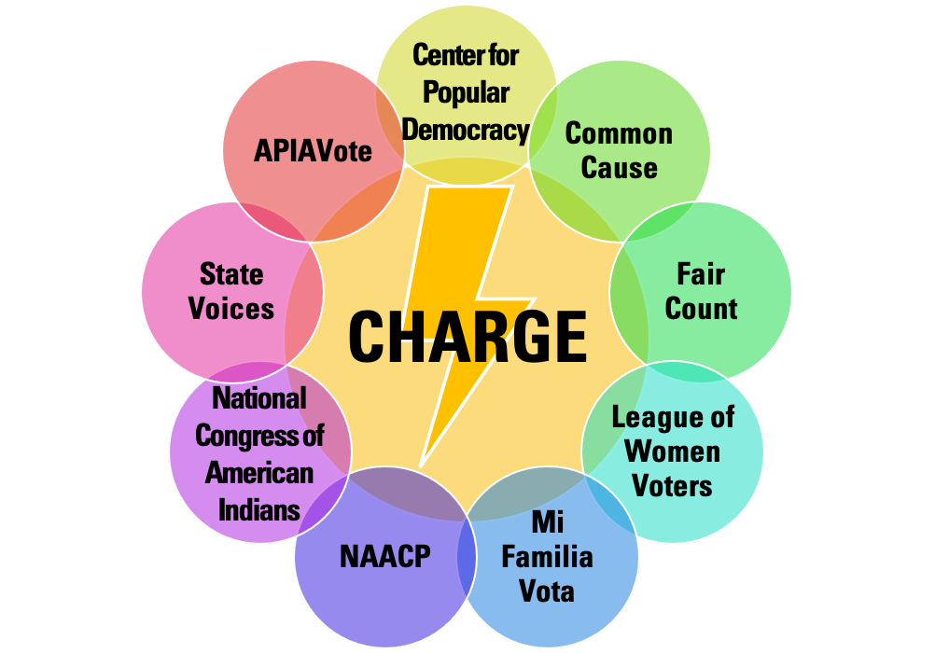
Why Community Mapping Matters
Communities: building blocks of redistricting.
Compelling community stories shift narrative from politicians and parties to everyday people.
Community stories are important for:
The media to cover
Lawmakers or commissioners who are drawing maps to hear
For courts to consider
Created by
Notes:
Let's talk a little bit about why community mapping matters. First, mapping communities can serve as the building blocks for drawing the districts in a city or state.
Second, by collecting and telling community stories, we can center our communities in redistricting, so we are not an afterthought, but considered from the start.
Telling compelling community stories is essential to changing how the media covers redistricting – from just covering it is as political power struggle between insiders to talking about the impact on people’s lives.
Most importantly, it can make a difference in how the lines are drawn, possibly persuading those who have the power to draw the lines – like lawmakers or commissioners – to consider our communities. And it may be incredibly important evidence for judges to consider if the maps are challenged in court.

Slide 10
A Role for Everyone
Community Mapping: How to run a workshop
Facilitator: person who gets the conversation going in a group about their community.
Community Mapper: person who listens to the community conversation to draw a community map
Ambassador: the one who spreads the word to invite people to the community workshop.
Helper: people who assist to make sure community workshop run smoothly
Created by
Notes:
Optional slide.
In any community mapping workshop, there can be different roles for different people.
The facilitator is the person who helps move along the conversation toward the identification of specific landmarks and areas that are important to the community.
The community mapper is the person who learns how to use the free mapping app and captures the places and descriptions that come out of the community conversation. This person will help eventually map the community.
An ambassador is someone who's well-connected in the community and invites people to participate in the workshop. The ambassador will also be in charge of asking, “who else needs to be part of the conversation?”
The helper is a person who can handle the logistics of the day that might come up.

Slide 11
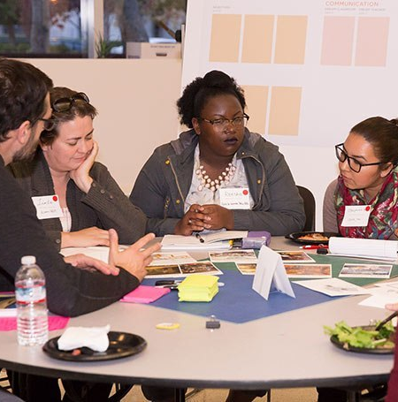
Community Mapping: How to run a workshop
Introduce yourself.
What makes our community special?
Introductions
The facilitator should start the conversation by going around the room (or Zoom), and asking people to introduce themselves, share what community they are from, and one thing that is special to them about their community.
Take good notes!
Note the PLACES, because you will the community mapper to mark these on the map. Note the stories about CULTURE and CONCERNS, because these map be part of a person’s testimony.
Created by
Notes:
In a community mapping workshop, the FACILITATOR should start the conversation by going around the room (or Zoom) and having people introduce themselves. Ask people to share what community they are from, and one thing that is special to them about their community.
The FACILITATOR and the COMMUNITY MAPPER should:
Listen carefully and take good notes. Are community members describing the same community? What are they saying about CULTURE/CHARACTER? Are they bringing up CONCERNS? When people describe the PLACES (or events that are tied to place), the Community Mapper should note it. Details like this will help the group when we get to putting the community on the map.

Slide 12
Community Mapping: How to run a workshop
Take a minute. Write down how you would describe our community to a friend thinking about moving here.
Created by
Notes:
The next step is to ask everyone to “Take a minute. Write down how you would describe our community to a friend thinking about moving here”
Here are some tips for the facilitator and mapper:
Write it down or share in chat: If you are meeting in person, have paper and pens ready to use. If you are meeting online, people can take a minute to write about their community in Chat box. The HELPER can help save all the comments from a chat in a separate document
Ask good questions: Participants might mention one or more place or stories of impact in passing. Ask them to tell you more about that story or place. Ask if other participants want to include it in a presentation to decisionmakers.

Slide 13
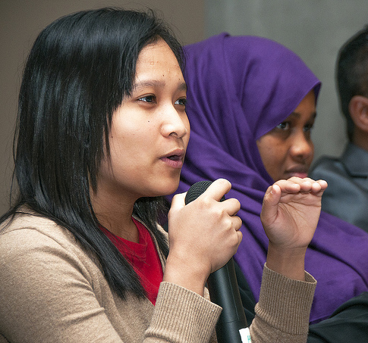
Community Mapping: How to run a workshop
Is there agreement on the name and general description of the community?
One community or more than one?
Help the group find consensus on how to describe their community
This Pho by Unknown Author is licensed under CC BY
Created by
Notes:
After some discussion, you will want to think about whether people are all talking about the same place or multiple communities. Do people have a similar understanding of the community?
If people are discussing more than one community, you can still map these. You will just want to be prepared to sort out which people are talking about as you are collecting information.

Slide 14
Community Mapping: How to run a workshop
Keep the discussion going!
Listen for stories that cover the 3 Cs:
CULTURE: How would you describe the people who are part of your community? What do we have in common? What is our history? What are our languages? What do we celebrate? What do we value?
CONCERNS: What issues need attention from government? What community projects need resources? Are there examples of elected officials ignoring our concerns?
COUNT: Is there data we can present that strengthens our stories? (Number of people in our community, % POC, income levels, distance from hospitals, lack of greenspace)
Created by
Notes:
Now let’s talk about the Three C’s.
The first C is for Culture (these are questions that the facilitator can ask to help flush out the history, languages, celebrations and values of a community) (NEXT)
The second C is for Concerns. The facilitator can ask questions to get the group to talk about what issues or services need resources or attention from the government) (NEXT)
The third C is for Count. (You will want to research additional data that can strengthen our community stories about how we are, what our concerns are, and where we live).
In the Redistricting Community Handbook, you can go to Page 12, and 15 through 17.

Slide 15
How to describe your Community
Community Mapping: How to run a workshop
Telling our stories
Culture/Character:
Long Beach has large Black and Latinx population
Washington neighborhood has a lot of working class Latinx families. When we have community gatherings, you will hear a lot of Spanish spoken.
Concerns:
Mrs. Zazueta: “At least every other day, I have to tell my 8-year-old daughter that she can’t play outside with her friends. She has asthma and we live in an area known as ‘Asthma Alley.’ We had to go to the hospital night after night because Emma would wake up gasping for air.”
Counts:
Washington neighborhood is one of the poorest parts of Long Beach, with almost 20% unemployment.
29% of households surveyed are home to at least one adult that has asthma, and 18.9% are home to at least one child with asthma.
This Long Beach community was split into three districts.
Created by
Notes:
Let's look at an example of how we can identify the three Cs. This is the port area of Long Beach. In 2001, in order to draw an incumbent into California Senate district 28, legislators extended a “boot” into the city of Long Beach to grab that incumbent's house. (That’s where the blue area is pointing). That meant that two other districts – Senate district 25 and 27 – had to be drawn around the “boot.” This split multiple communities and the city of Long Beach into three districts.
[NEXT] Let’s look at the Culture of this area?
This area has large Black community (you can see the areas shaded in reds and oranges). There is also a mix of Latinx working class families, so you will hear Spanish spoken as much as English at gatherings.
[NEXT] What are some of the Concerns?
There are two ports (Port of Los Angeles and the Port of Long Beach) in this area. These Long Beach neighborhoods experience the traffic and pollution from the non-stop caravans of 18-wheelers driving on the freeways to pick up goods shipped through the ports. The families in these neighborhoods, like the Washington neighborhood, suffer serious health problems because of this pollution. As the story from Mrs. Zazueta shows, the truck and port pollution means that her daughter has asthma and has to be rushed to the hospital several times a week because she cannot breathe.
[NEXT] What are the Counts?
This community can cite to several compelling numbers. For instance, one third of the families have an adult or child with asthma. This area has so many Asthma cases, it is called “Asthma Alley.”
The way districts were drawn, the representatives who have the ports were not the same as those who have parts of the communities who are experience health problems from port traffic pollution. Unifying the neighborhoods impacted by the port traffic into one district would give communities a chance to elect someone who would listen to and address these concerns.

Slide 16
How to describe your Community
Community Mapping: Practice Mapping
Community testimony helped unify Long Beach
With one representative, issues like the health of working class, POC communities impacted by the ports and freeways are starting to be addressed.
Created by
Notes:
When community members came together to testify about their community, the districts were redrawn by the new CA Citizens Redistricting Commission. As you can see, the new lines put the communities impacted by the Long Beach port and freeways into one district. Now, the new representative who represents these communities has advanced bills that address the health and environmental impacts of the trucks and ships on these communities.

Slide 17
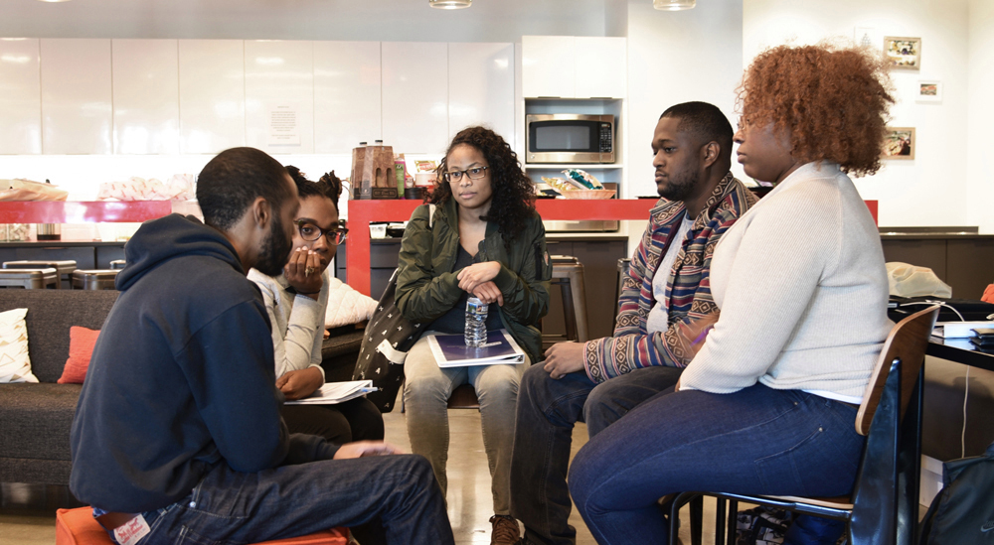
How to describe your Community
Community Mapping: How to run a workshop
Breakouts will give you a chance to:
Try out the new free mapping apps:
Dave’s Redistricting App – To learn how to evaluate maps, and other bells and whistles.
DistrictR.org – to learn how to map your community, and other bells and whistles.
Representable.org – to learn how to map your community
Meet teams of people who can help if you want to bring these conversations to your community.
Talk with others who may be in your same state or share similar concerns.
You will stay in the same breakouts through the day.
This Photo by Unknown Author is licensed under CC BY-NC
Notes:
Now I'll turn the time back over to Lauren, our wonderful tech host that will assist us in getting into our breakout rooms.

