Slide 1
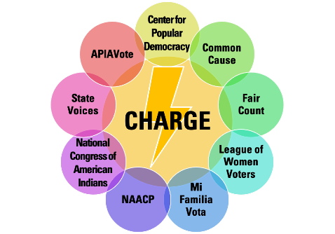
REDISTRICTING:
UNDERSTANDING THE
INTERSECTION OF THE
VOTING RIGHTS ACT

Slide 2
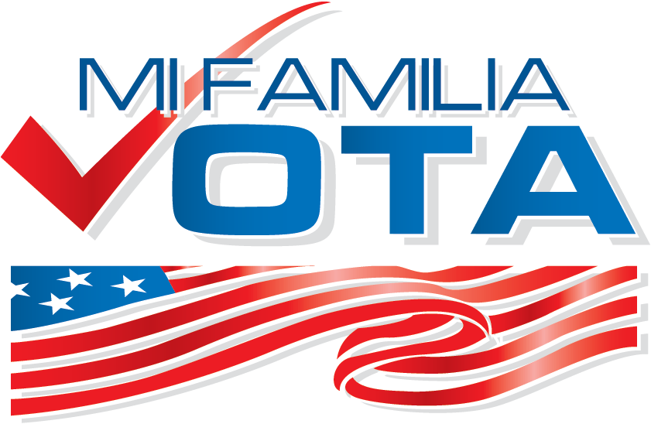
REDISTRICTING: THE ROAD TO 2022
Minority Vote Dilution - Packing and Cracking
Federal Protection - 1965 Voting Rights Act
Focus On Ongoing Efforts - Communities of Interest

Slide 3
ICEBREAKER
Please take a few minutes and look up the “Districts” that you currently live in …
Examples:
City Council District
School District
County District
State House District
State Senate District
Congressional District – US House
Congressional – US Senate?
Share your thoughts about your “Districts” in the chat!
How are they similar? Different?
Any insights?

Slide 4
What is Minority Vote Dilution?

Slide 5
Drawing Districts
FAIR
NOT FAIR

Slide 6
In communities of color, practices commonly known as packing and cracking occur to dilute the voting strength of the community.
Redistricting has been used at times to prevent minority voters from gaining political power by drawing districts in a way that resulted in those voters having less of a chance of electing their candidate(s) of choice.
This is known as minority vote dilution, and it commonly can be seen when map drawers use techniques, such as, packing and cracking.
Districts are drawn based on the cohesion of like-minded groups, but shapes of districts need not be perfectly geometric.

Slide 7
What is PACKING?
Packing is the term used when minority voters are compressed into a smaller number of districts to waste their collective strength, instead of effectively controlling one district or more.
An example is when mapmakers draw one district that is over 90% of a single minority group (BLUE), when one could draw two districts each with 50% single minority group.
Source: Common Cause

Slide 8
What is CRACKING?
Spreading (splitting apart areas of) minority voters thinly into many districts is known as cracking, splitting, or fracturing.
An example of cracking can occur if three districts are created that have 40% of a single minority population in each. If the minority population (BLUE) were placed within one district where they are 70%, the minority community would have an opportunity to elect a candidate of their choice.
Source: Common Cause

Slide 9
Protection From the Voting Rights Act …
Passed at the height of the Civil Rights Movement in 1965, the Voting Rights Act was and is designed to prevent the systemic and widespread voter discrimination experienced by people of color.
The Voting Rights Act of 1965 is widely considered to be the single most important federal statute protecting the right to vote.
The act contains a number of important provisions, but today it is Section 2 of the act that continues to have a major impact.
Adopted essentially as an enforcement mechanism for the 15th Amendment’s guarantee that the right to vote cannot be abridged “on account of race, color, or previous condition of servitude,” Section 2 allows voters to seek judicial relief if they believe that a state or local government has denied or limited their voting rights on the basis of their race, color or membership in a language minority group.

Slide 10
Protection From the Voting Rights Act …
As amended in 1982, Section 2 now provides that a voting process or requirement that results in the abridgement of the right to vote on account of a voter’s race, color or language minority status is unlawful, whether or not an intent to discriminate can be proven.
The revised statute further provides that whether a discriminatory result has occurred requires considering the “totality of the circumstances” to determine whether the challenged voting restriction has abridged protected voters’ ability to participate equally in elections and to elect representatives of their choice.
Section 2 has given rise to both “vote dilution” claims and “vote deprivation” claims.
Vote dilution claims, which typically involve redistricting schemes or at-large voting systems, have produced a complicated judicial doctrine resulting from several high-profile Supreme Court decisions.
Legislative history of the amendment to Section 2, primarily in the form of a Senate Judiciary Committee report, offered a number of factors that courts could consider in evaluating the totality of the circumstances.

Slide 11
Protection From the Voting Rights Act …
In 1986, in Thornburg v. Gingles, the Supreme Court reviewed these factors in clarifying the test for a vote dilution claim. The court held that a successful claim requires showing that: (1) the affected minority group is sufficiently large to elect a representative of its choice; (2) the minority group is politically cohesive; and (3) white majority voters vote sufficiently as a bloc to usually defeat the minority group’s preferred candidates.
In subsequent cases, the court has ruled that Section 2 does not require a state to maximize the number of districts in which a minority group can elect preferred candidates (Johnson v. DeGrandy, 1994), and that, to satisfy the first Gingles requirement, the minority group must show that it could constitute a majority in some hypothetical district, not simply that it could serve as the swing vote in a competitive district (Bartlett v. Strickland, 2009).
Other cases (including Bethune-Hill v. Virginia State Board of Elections and Cooper v. Harris, both in 2017) have considered the extent to which a fear of Section 2 liability can justify drawing district lines primarily on the basis of race, when a separate line of Supreme Court jurisprudence (beginning with Shaw v. Reno, 1993) establishes that using race to draw districts can violate the 14th Amendment’s equal protection clause.

Slide 12
Protection From the Voting Rights Act?
Criteria for majority-minority districts:
(Protected under VRA, section 2) To ensure people are in districts that give them a fair chance of electing candidates of their choice, Section 2 of the Voting Rights Act protects certain criteria for drawing majority minority districts.
The minority group is sufficiently large and geographically concentrated to make up a majority in a district.
The minority group is politically cohesive. This means that the individuals that make up the group vote in similar patterns, e.g. they usually vote for the same candidates.
The white majority usually votes together to defeat the minority-preferred candidates.
Given the “totality of circumstances” listed above, the minority group has less opportunity than other members of the electorate to participate in the electoral process and to elect representatives of its choice.
Other types of districts include: minority-coalition districts, crossover districts, influence districts

Slide 13
Arizona – Congressional District 3

Slide 14
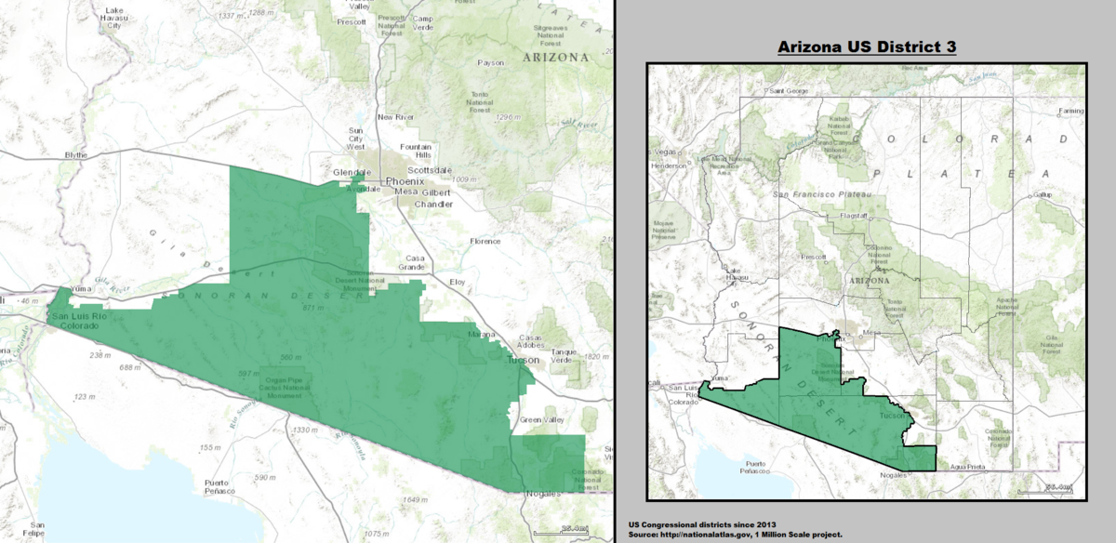
Arizona's 3rd congressional district is a congressional district that contains the southwestern portions of the state, sharing the border of Mexico from Nogales to the California border.
Much of the district's population lives in the western third of Tucson.
It is currently represented by Congressman Raúl Grijalva.
U.S. Census Bureau (2010 data)^{[1]}
Population: 707,336
Gender: 50.5% Male, 49.5% Female
Race^{[2]}: 71.9% White, 5.3% Native Am., 4.5% Black, 1.5% Asian
Ethnicity: 61.1% Hispanic
Unemployment: 14.8%
Median household income $37,771
High school graduation rate 73.3%
College graduation rate 15.8%
Notes:
Arizona - District 3

Slide 15
Fair Maps Objectives:
Draw equitable and inclusive maps that ensure that voters of color have an opportunity to elect candidates of their choice
Change the Rules Where Possible
Defend the Rules Where Necessary (Litigation)
Advocate and Agitate to Shape the Debate, Create a Political Demand and Push the Right Narrative
Notes:
Main parts of a VR program-Ariel
Setting up clipboard/materials-Ariel
The rap-Amy
Overcoming objections-Amy
ROLEPLAY-Amy and Ariel
Understanding the Numbers-Amy
Pitfalls-Ariel
De-escalation-Ariel

Slide 16
EDUCATION - To engage the general public, advocates and activist through our various channels on how to impact the drawing of equitable maps through understanding the state and local political and demographic landscape, leveraging community partnership spaces and approaches like Communities of interest.
TRAINING - Provide technical training on the use of the tabular data and other data sets to assess and draw maps. This will be for a niche grouping but understanding the range of tools and resources are essential to empowering community engagement.
ADVOCACY - To continue to advocate for fair and inclusive maps, and the end of packing, cracking and prison gerrymandering. To lift up redistricting community engagement at the grassroots and grasstops level.
LITIGATION – To intervene through the courts when and where necessary.

Slide 17
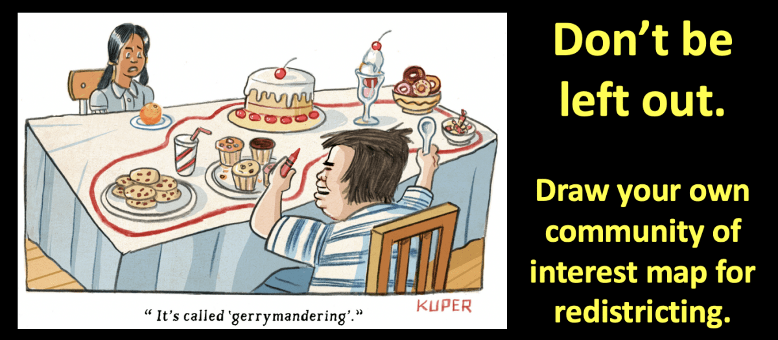
Focus of Ongoing Efforts: Independent redistricting based on “communities of interest”
Community of Interest – A neighborhood, community, or group of people who have common policy concerns and would benefit from being maintained in a single district.
Focus of a lot of state efforts, and currently in H.R. 1, Reflected in S1
Would be a big step forward in:
preventing extreme, intentional minority vote dilution; and,
helping to mobilize communities.

Slide 18
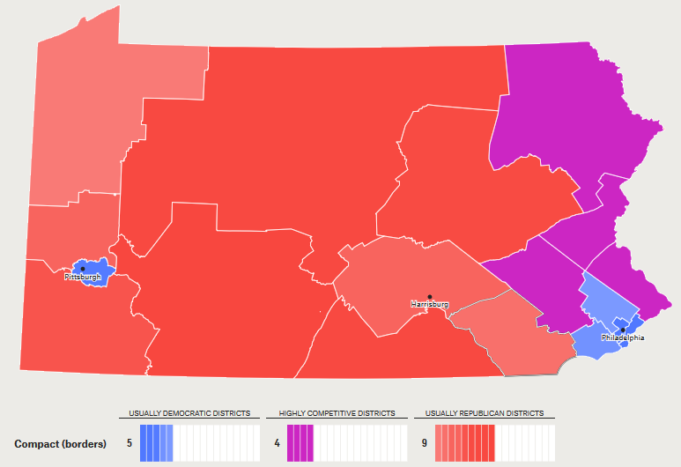
However, this approach isn’t a guaranteed fix for racial exclusion …
Communities of color are clustered in cities while their white counterparts are more spread out in rural areas
That means that an approach centered on compact, community-based districts that does not take demographics data into account will produce unintentional racialized gerrymanders.
Pennsylvania, for example, would likely look the same way it does now: heavily skewed towards white voting blocks.
Pennsylvania with compact districts that don’t split communities:
Still disadvantages communities of color.

Slide 19
RESOURCES:
www.redistrictingcommunitycollege.com

Slide 20
KEY TERMS - A
Census – The counting and survey of every person in a population. In the U.S., a census is taken every ten years. The census is required by the Constitution for reapportionment and is used in the redistricting process.
Census Bureau – The federal government agency that administers the census. Citizen Voting Age Population (CVAP) – Citizen Voting Age Population (CVAP) is the total population age 18 and over and a citizen. (Related to VAP)
Coalition District – A district where the combined racial minorities make up a majority of the population and where the voters from these different racial groups vote together to elect the minority-preferred candidate. Coalition districts are not legally required by the Voting Rights Act. (Also called Minority Coalition District)
Community of Interest – A neighborhood, community, or group of people who have common policy concerns and would benefit from being maintained in a single district.
Compactness – Compactness refers to the shape of the district. It describes boundaries that are drawn closely and neatly packed together unless there are good reasons such as VRA compliance or following oddly shaped boundaries, like city boundaries or rivers.
Contiguity – A characteristic describing a boundary’s single and uninterrupted shape (i.e. all areas in the district are physically connected to each other).

Slide 21
KEY TERMS - B
Cracking – A splitting of a racial minority community into two or more districts so that the minority community is not a significant portion of any district. For example, cracking occurs when a minority population is big enough that it can make up 50% of one district but, instead, is divided into two or more districts so that the minority community makes up a small percentage in each district.
Crossover or Opportunity District – A district where some majority voters “cross over” to vote with racial minorities to elect the minority-preferred candidate. Crossover or opportunity districts are not legally required by the Voting Rights Act.
Deviation and Deviation Range – A district map’s Deviation is the difference (percent down or up) of a district’s population from the Ideal Population. The entire plan’s Deviation Range is the largest deviation to the smallest deviation.
Gingles and Senate factors – US Supreme Court case, Gingles v Thornburg, sets forth controlling legal factors and analysis in finding whether redistricting maps were racially gerrymandered, and have or have not violated the VRA
Ideal Population – The total population goal for districts in a redistricting plan. It is computed by taking the total population of the jurisdiction and dividing it by the total number of districts in the redistricting plan. Congressional mapping uses one absolute number.
Incumbency (criteria) – Making sure the current elected official’s house remains in a district.
Influence District – A district where a racial or ethnic minority group does not make up a majority of voters but does have enough members of the minority group to influence substantially an election or the decisions of an elected representative.
Gerrymandering – Drawing of district lines to give one group an unfair advantage over another group. Gerrymandering is not the same as redistricting, but gerrymandering can occur during redistricting. Drawing majority-minority districts to comply with the Voting Rights Act is not gerrymandering.

Slide 22
KEY TERMS - C
GIS (Geographic Information System) – Computer software used to create redistricting maps.
Majority-Minority District – A district where one racial minority equals 50% or more of the citizen voting-age population. In combination with a few other factors, a majority-minority district may be required by the VRA.
Minority vote dilution – Drawing districts which result in minority voters having less of a fair chance of electing their “preferred candidate(s)” of choice. This is often done by “packing” or “cracking.”
Nesting – A redistricting rule where each upper house (such as the state senate) district is made up of two lower house districts (such as the state assembly).
One Person, One Vote – The Equal Population rule that describes the constitutional requirement that each district be substantially equal in total population. Each Cogressional district must be 100% equal in population. Typically, this means that every district in a redistricting plan should contain the same number of people, regardless of age or citizenship.
Packing – To manipulate lines putting a racial minority population into a suboptimal number of districts. For example, packing occurs when a minority population makes up 55-90% of the district instead of being split into two districts where the minority population makes up less than 50% of each district.
Reapportionment – The redistribution of seats in the U.S. House of Representatives based on changes in a state’s population. This occurs so that a state’s representation in Congress is proportional to its population. Reapportionment is not redistricting, although some states use the terms interchangeably.

Slide 23
KEY TERMS - D
Redistricting – The process used by governments to redraw political district boundaries and applies to all levels of government where district elections are held. Maps are redrawn every ten years after the Census to create districts with substantially equal populations to, at minimum, account for population shifts. There are many types of Redistricting Processes.
Totality of circumstances – A consideration of all the circumstances to decide a case, rather than any one factor or rule.
Unity Map – A proposed map drawn by a coalition of multiple community groups that demonstrates their multiple communities of interest can be simultaneously respected.
Voting Age Population (VAP) – The total population ages 18 and over. (Related to CVAP)
Voting Rights Act (VRA) – The federal legislation passed in 1965 to ensure state and local governments do not pass laws or policies that deny American citizens the equal right to vote based on race. Section 2 of the VRA protects voters from discrimination based on race, color, or membership in a language minority group in all election procedures.

