Slide 1
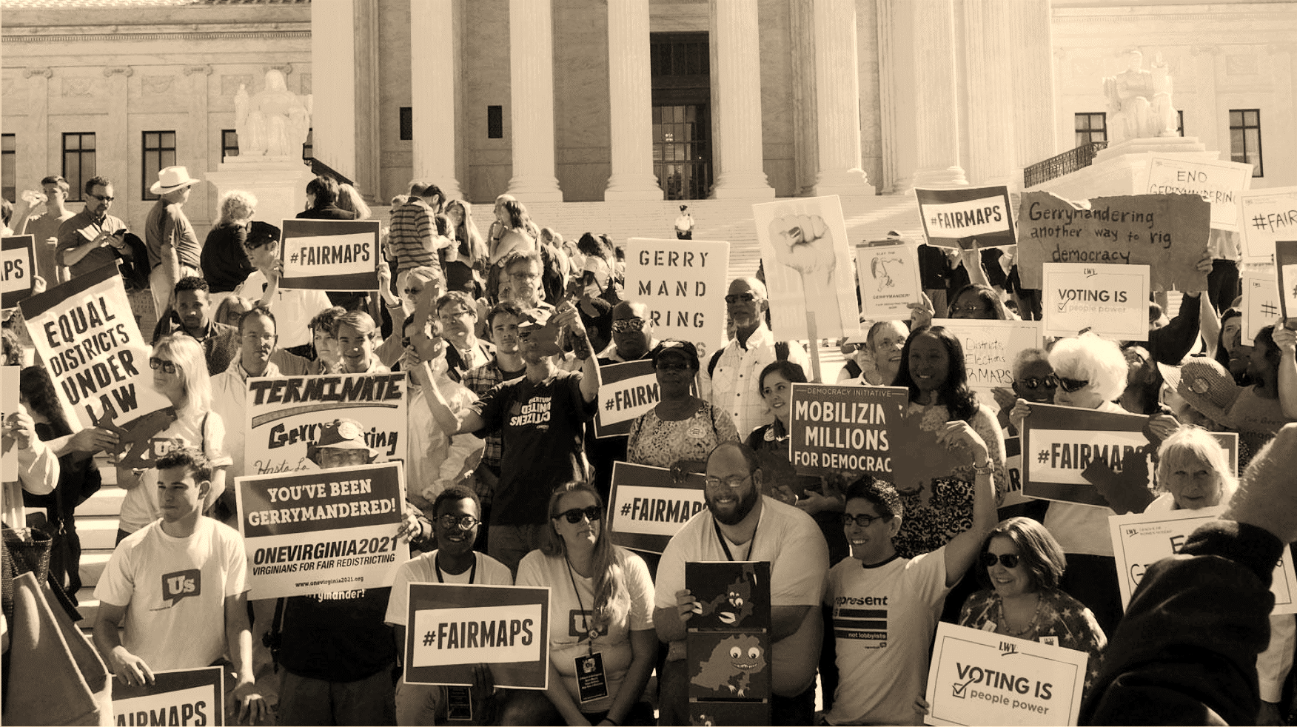
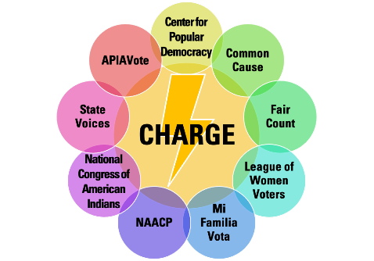
Introduction to Redistricting
Notes:
Introduce yourself.

Slide 2
Redistricting Community College
Curriculum
Part 1. Introduction to Redistricting What is Redistricting? How does it work? Why should we care?
Part 2. Voting Rights Act What is the Voting Rights Act? How does it protect minority communities?
Part 3A. Community Mapping – Training for Trainers Why is community mapping important? How do we define our community? What stories are we looking for? What data would help? Breakout - Learning to use the free community mapping apps How do we use the free mapping apps? What are the features? How do we share maps in a coalition?
Part 4. Redistricting Timelines and Rules
Part 5. Redistricting Advocacy: Improving Transparency and Providing Testimony How do we advocate, in virtual and in-person settings, for more transparent and inclusive procedures? How do we give effective testimony? Breakout – Crafting Testimony What makes effective testimony?
Part 6. Redistricting Coalition Building and Organizing How do we do a power analysis? How do we build strong coalitions? What are effective organizing strategies to build power? Breakout – Crafting a Power Analysis How to build coalitions and reach communities
Notes:
This is Part 1, Introduction to Redistricting, of the 6-part training of the Redistricting Community College training.

Slide 3
Introduction to Redistricting: What you will learn
What is redistricting?
Why does redistricting matter?
How do we organize to put our community on the map?

Slide 4
What is redistricting?
Introduction: What is redistricting?
5
5
Redistricting is when we redraw districts so each has the same number of residents.
5
5
Notes:
What is Redistricting? Redistricting is when we redraw districts so that each district has the same number of residents.
The United States Constitution requires that political districts of the same type have the same number of residents. This is called the principle of Population Equality. At every level of redistricting, this is the first rule that has to be followed.
The goal of population equality is to make sure that each legislator represents the same number of people. Let’s say we have a city with 20 people.
[NEXT]
In this city, we have 4 council districts. You take the total population of the city - 20 - and divide it by the number of districts – 4. You get the ideal population for each district – 5, so you are aiming to have 5 people in each district to have population equality. Notice, I said “people.” In redistricting, we draw districts using the total number of people – we do not exclude people based on citizenship or age.
This rule of drawing districts with equal population applies to all levels of government, including congressional districts, state districts, county, city and even school board districts.

Slide 5
What is redistricting?
Introduction: What is redistricting?
Over time, districts become uneven in size.
5
8
4
7
Notes:
Over time, people move. Children are born, people pass away. This means some places have population growth, and other have decreases in population. For example, in times of economic crisis, people may move to places where rent and housing prices are cheaper.
Because of this, districts become uneven in size during the course of a decade.

Slide 6
What is redistricting?
Introduction: What is redistricting?
Every ten years, we count people again, and then redraw the district lines to have an even number of people again.
6
6
6
6
Notes:
And so every 10 years, the federal government counts everyone in the country – the census.
After the census is finished, the district boundaries must be redrawn to even out the number of people in each district – this is called redistricting.
In our City, the population grew from 20 to 24 in the last 10 years. It did not grow evenly, so new district lines have to be drawn (purple) replacing the old ones (blue dotted lines). With the new lines, each district now contains six people.
*PAUSE FOR QUESTIONS*

Slide 7
Introduction: Why does redistricting matter?
Redistricting can take away minority voting rights.
Minorities make up only
¼ of each district
Notes:
For better or for worse, different segments of our population have differing political views. These views may be connected to race, income, where people live, and party.
Where there are these differences in viewpoints, the way district maps are drawn can determine whether a group of people have the ability to elect candidates of their choice, or at least influence the outcome of elections.
In this example, we have a racial minority community that lives in the center of the state.
[NEXT]
If the people in charge of drawing lines do not pay attention to where the minority community is, they might draw the district lines this way to be perfectly compact, but split the minority population into four. This minority community cannot elect a candidate of their choice because they are only ¼ of each district.
Sometimes the way the lines are drawn are intended to dilute the votes of a group.
This same dynamic plays out with any group that is a political minority – for example, Democrats in heavily Republican areas, Republicans in heavily Democratic areas, and other groups that are politically cohesive, but have views different from those of the majority population.

Slide 8
Why does redistricting matter?
Introduction: Why does redistricting matter?
When we organize, we can elect candidates of our community’s choice.
Minorities make up
a majority of this district
If a majority can be drawn, the Voting Rights Act
may require it
Notes:
But things could be different if we draw the district lines another way. This community could unite to tell the line drawers to pay attention to where they are.
[NEXT]
Now the lines are drawn to take into consideration the community testimony, and they have been made whole. The minority population makes up over three-quarters of the population in the middle district.
After Equal Population, the next most important rule in redistricting is the Voting Rights Act. The Voting Rights Act can provide protection for racial and ethnic minorities in a situation like this one.
We will talk about the Voting Rights Act and how it works in Part 2 of the Redistricting Community College curriculum.

Slide 9
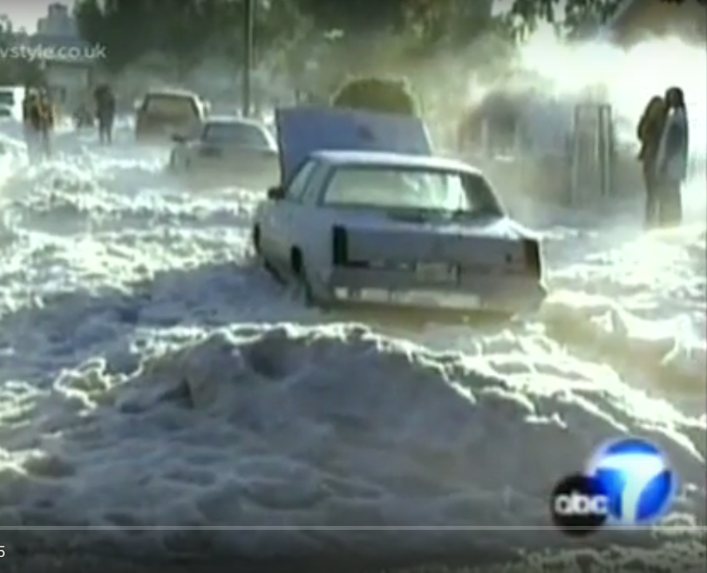
Take a guess where this picture is from
Created by
Notes:
Let's move from a hypothethical district to a real one. Using the Chat Box, what community do you think this picture is from?
(Allow people to guess.)
Answer: This is in Watts, a neighborhood of Los Angeles that was historically Black and has a large growing Latino population. This community is in Southern California and anyone who knows Southern California knows we don’t get snow like this.

Slide 10
In a time of need, Watts was ignored.
Created by
Notes:
On November 12, 2003, a freak storm dumped over 5 inches of rain and hail on Watts, overwhelming storm drains and flooding the community. About 150 buildings and homes were heavily damaged, 50,000 people lost power, and 6,000 people sought aid from the county’s emergency center. Firefighters rescued about 100 people from waistdeep water and snow.
Many people had lost everything – they had no place to live, they possessions were flooded out when the snow melted.
Leaders went to their elected representatives to ask for help. But it took a long time.
Why? Redistricting played a role in that.

Slide 11
In 2001, Watts was split by incumbents into 3 districts at the Congressional level.
Why?
Because Watts neighborhood was split by district lines.
Created by
Notes:
You see, Watts was split into three districts at the congressional level. So when community residents went to ask for help, no one congressional representative was standing up to call for federal emergency aid.
(Here, Watts is the community shaded green. The congressional lines are red, and you can see how they cut Watts into three pieces).

Slide 12
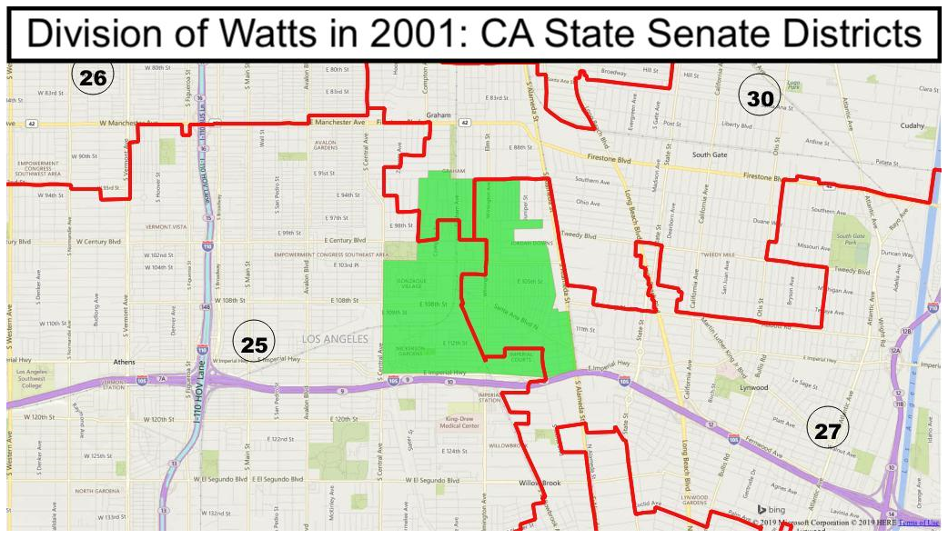
In 2001, Watts was split by incumbents into 3 districts at the state Senate level.
Watts had no political voice because it was split.
Created by
Notes:
Watts was split at the state level into multiple Senate and assembly districts. No wonder they could not get representation.

Slide 13
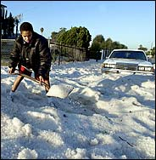
“At the time of the 2003 flood, I remember our office trying to be very responsive, but there was a lot of ping-ponging of constituents between elected representatives. Residents weren't sure who actually was their member of Congress.
Watts is cut into three different Congressional and state Senate districts. Residents who live on the same street may live in different districts. There was a lot of unnecessary frustration for constituents during a difficult time.
This would have never happened if all of Watts belonged to one district.”
- Romulo Rivera, former Congressional staffer
Community
voices and needs were abandoned.
Created by
Notes:
The community leaders of Watts could not get members of Congress to declare a federal emergency to help them rebuild, because they were split into three districts.
In fact, Romulo Rivera, former congressional staffer, remembers when the residents of Watts came in to ask for assistance. They were bounced from one congressional office to another because no one representative felt entirely responsible for the care of that community.
Romulo Rivera said:
“This would have never happened if Watts belonged to one district.”

Slide 14
After 2011, the community united to testify about Watts before the CA Citizens Redistricting Commission.
Watts was made whole.
Organizing our communities can ensure our voices are heard
Created by
Notes:
In 2011, the leaders united to testify about Watts before the CA Citizens Commission. As a result, Watts was made whole. (P.S. the new 44th congressional district elected Nanette Barragán, the first Latina ever to represent this district in 2012).
We will talk about how to do community mapping in Part 3 of the Redistricting Community College Curriculum.

Slide 15
How do we organize to put our community on the map?
Introduction:
What level of redistricting do we want to be involved in – congress? state? county? city? School board?
What are the rules and timelines?
Created by
Notes:
As you learn more about redistricting, you will want to think about which level of redistricting your organization wants to get involved in. Congressional? State? Local redistricting? Each level may have different rules and timelines.
In Section 4, we will talk a little about Timelines and Rules, and share resources that can help you find out more about redistricting in your area.
Today, we will also talk about the Rules and Timelines of redistricting, and How to prepare for testimony and advocacy, and how to build a coalition that increases power. These are just some of the questions that you will want to start to think about.

Slide 16
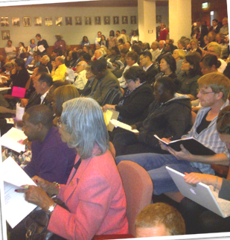
How do we organize to put our community on the map?
Introduction:
Find out how to give input:
When are public hearings?
Who makes the mapping decisions?
How do we submit information? By email, through a web portal, in person?
You can get started by checking out the resources at: redistrictingcommunitycollege.com
Created by
Notes:
Once you have decided which level of government you are interested in focusing on, you can research key questions, like:
- Will there be public hearings and when?
Who makes the mapping decisions? Is it elected lawmakers? Is it a commission? Is it a variation on these?
How do we submit information to these decision makers.
In Part 5 of the Redistricting Community College curriculum, we will talk about strategies for giving AMAZING testimony, for watchdogging the process to make sure it is inclusive and open.
We have worksheets and a handbook as well that you can find on the Redistricting Community College website.

Slide 17
How do we organize to put our community on the map?
Introduction:
Who should be at the table to describe our community?
Are there other folks we want to invite?
Who are possible allies we want to reach out to increase our power?
Created by
Notes:
The key to changing the district maps are drawn is to build strong coalitions.
In Part 6, we will talk about how to build strong alliances and coalitions to give power to your advocacy.

Slide 18
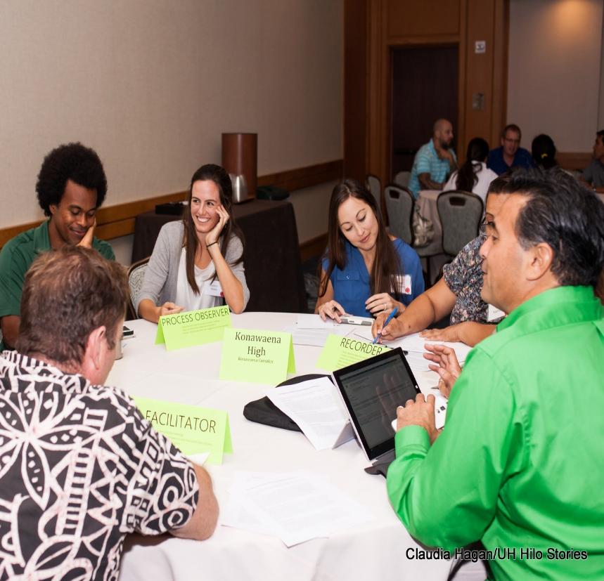
How do we organize to put our community on the map?
Introduction:
Who is the best expert to talk about your community?
YOU!
Good redistricting starts with
good community organizing
Created by
Notes:
Good redistricting starts with good community organizing
Communities can get involved in redistricting by telling the story of your communities. And you are well on the way to organizing to be heard.
You have heard the story of Watts. How would you describe your community? You have the knowledge and the relationships to tell your community’s story best!

