Slide 1
2020 Presidential Election Maryland Vote
Presenter Name
Email
Additional Contact Info

Slide 2
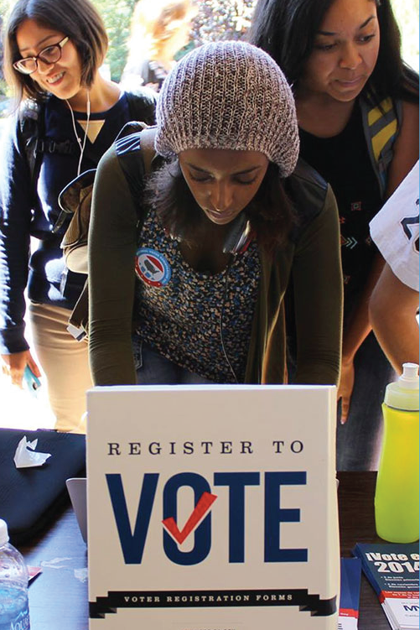
VOTER REGISTRATION
Verify that you are registered to vote and that your information is up to date.
Vote Registration Deadline: Oct. 13th
elections.maryland.gov/2020
U.S. citizen
Maryland resident
At least 16 years old
If you’re not serving time for a felony conviction, you have the right to register and vote.
*If you update your voter registration at a vote center, you will be asked to cast a provisional vote.

Slide 3
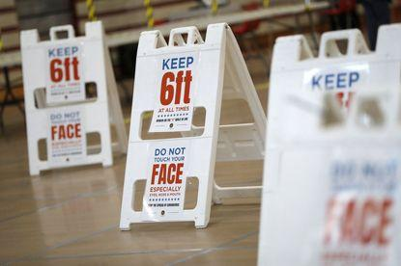
MAKE A PLAN
Choose whether you want to vote using a mail-in ballot or in-person at a vote center.
Once you make a plan, stick to that plan.
Voters who request a ballot and decide to go vote in-person will be asked to vote on a provisional ballot.
Why? Records show that you received a mail-in ballot for then election. If you have not already voted, election officials will count your provisional ballot.

Slide 4
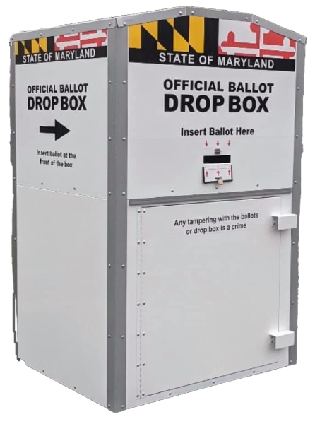
VOTING BY MAIL
VOTERS WILL BE MAILED A BALLOT UPON REQUEST
To request you ballot or check request status, visit elections.maryland.gov
Request Deadline: Oct. 20th (must be received by this date)
*Paper application available online for those unable to use online form because of ID requirements.
Benefits of voting by mail
Voter Education: voters have time to sit with the ballot and do their research
Convenience: voters no longer have to worry about things link transportation and schedule.
Notes:
I would also mention that they can request their ballot be mailed somewhere else via that site
I would mention the register to vote and mail in the form, your absentee ballot requires an ID

Slide 5
VOTING BY MAIL continued
USPS: If returning you ballot by mail, don’t wait. Mail your ballot as soon as possible. We recommend mailing no later than Oct. 27^{th.}
Drop Boxes: Monitored 24/7. Ballots picked up at least 2x each day leading up to Election Day. Drop off early if you can!
Electronic Ballots: ballots are not to be returned by email. You also need to have access to a printer, return envelope, and postage.
Sign It: Make sure your vote is counted. Seal and sign your return envelope. Deliver before 11/3, 8pm.

Slide 6
VOTE CENTERS
If you choose to vote in-person, vote early!
Early Vote: Oct. 26-Nov. 3rd (7am-8pm)
Election Day: Tuesday, Nov. 3rd, (7am-8pm)
Each county will have numerous vote centers. Voters can go to any location in their county.
Same day registration will be available throughout all days of in-person voting, but voters encouraged to register by Oct. 13th deadline.
Vote centers will have accessible ballot marking devices, language assistance.
Voters going to these locations must wear masks, maintain strict social distancing and sanitation protocols.

Slide 7
IMPORTANT DATES RECAP
Oct. 13th - deadline to register to vote
Oct. 20th – ballot requests must be received by this date
Oct. 26-Nov. 2nd – early voting period
If returning ballot by USPS, mail back by Oct. 27th
Nov. 3rd – Election Day! Ballots must be postmarked by this date; in-person voting; don’t expect results on this night
*To check on the status of your request or voted ballot, visit
elections.maryland.gov

Slide 8
YOUR RIGHTS AS A VOTER:
If you are in line when polls are supposed to close, stay in line – you have the right to vote.
If you make a mistake on your ballot, ask for a new one.
If your citizenship, criminal record, or other qualifications are questioned, immediately call an Election Protection Hotline.
If you run into any problems and can’t get the assistance needed from election officials, call an Election Protection Hotline.
ELECTION PROTECTION HOTLINE:
866-OUR-VOTE

Slide 9
For more info, visit
Elections.Maryland.gov/2020

